Slide 1
Lecture 6: Recurrent Neural Networks and NLP source: https://calvinfeng.gitbook.io/machine-learning-notebook/supervised-learning/recurrent-neural-network/recurrent_neural_networks
Notes:
https://calvinfeng.gitbook.io/machine-learning-notebook/supervised-learning/recurrent-neural-network/recurrent_neural_networks

Slide 2
Recap: Training Neural Networks
One time setup
Activation functions, data preprocessing, weight initialization, regularization
Training dynamics
Learning rate schedules; hyperparameter optimization
After training
Model ensembles, transfer learning, large-batch training

Slide 3
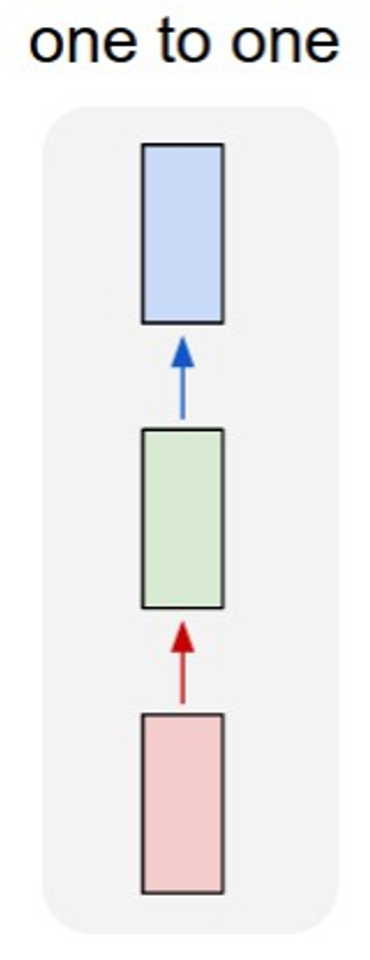
So far: “Feedforward” Neural Networks
e.g. Image classification
Image -> Label
Notes:
RED = INPUT LAYER
GREEN = BACKBONE LAYERS USED TO EXTRACT FEATURES
BLUE = OUTPUT LAYER

Slide 4
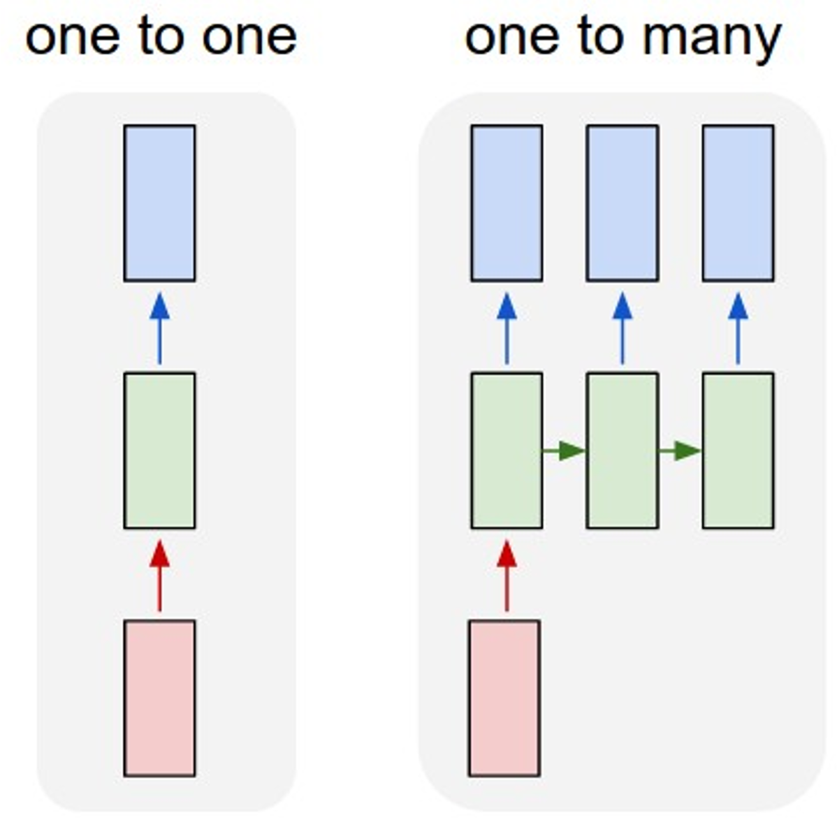
Recurrent Neural Networks: Process Sequences
e.g. Image Captioning: Image -> sequence of words
Notes:
RED = INPUT LAYER
GREEN = BACKBONE LAYERS USED TO EXTRACT FEATURES
BLUE = OUTPUT LAYER
*Image captioning: predict a sequence of words by sequentially predicting one word and the next word that should follow based on image input and input from previous word in the sequence.

Slide 5
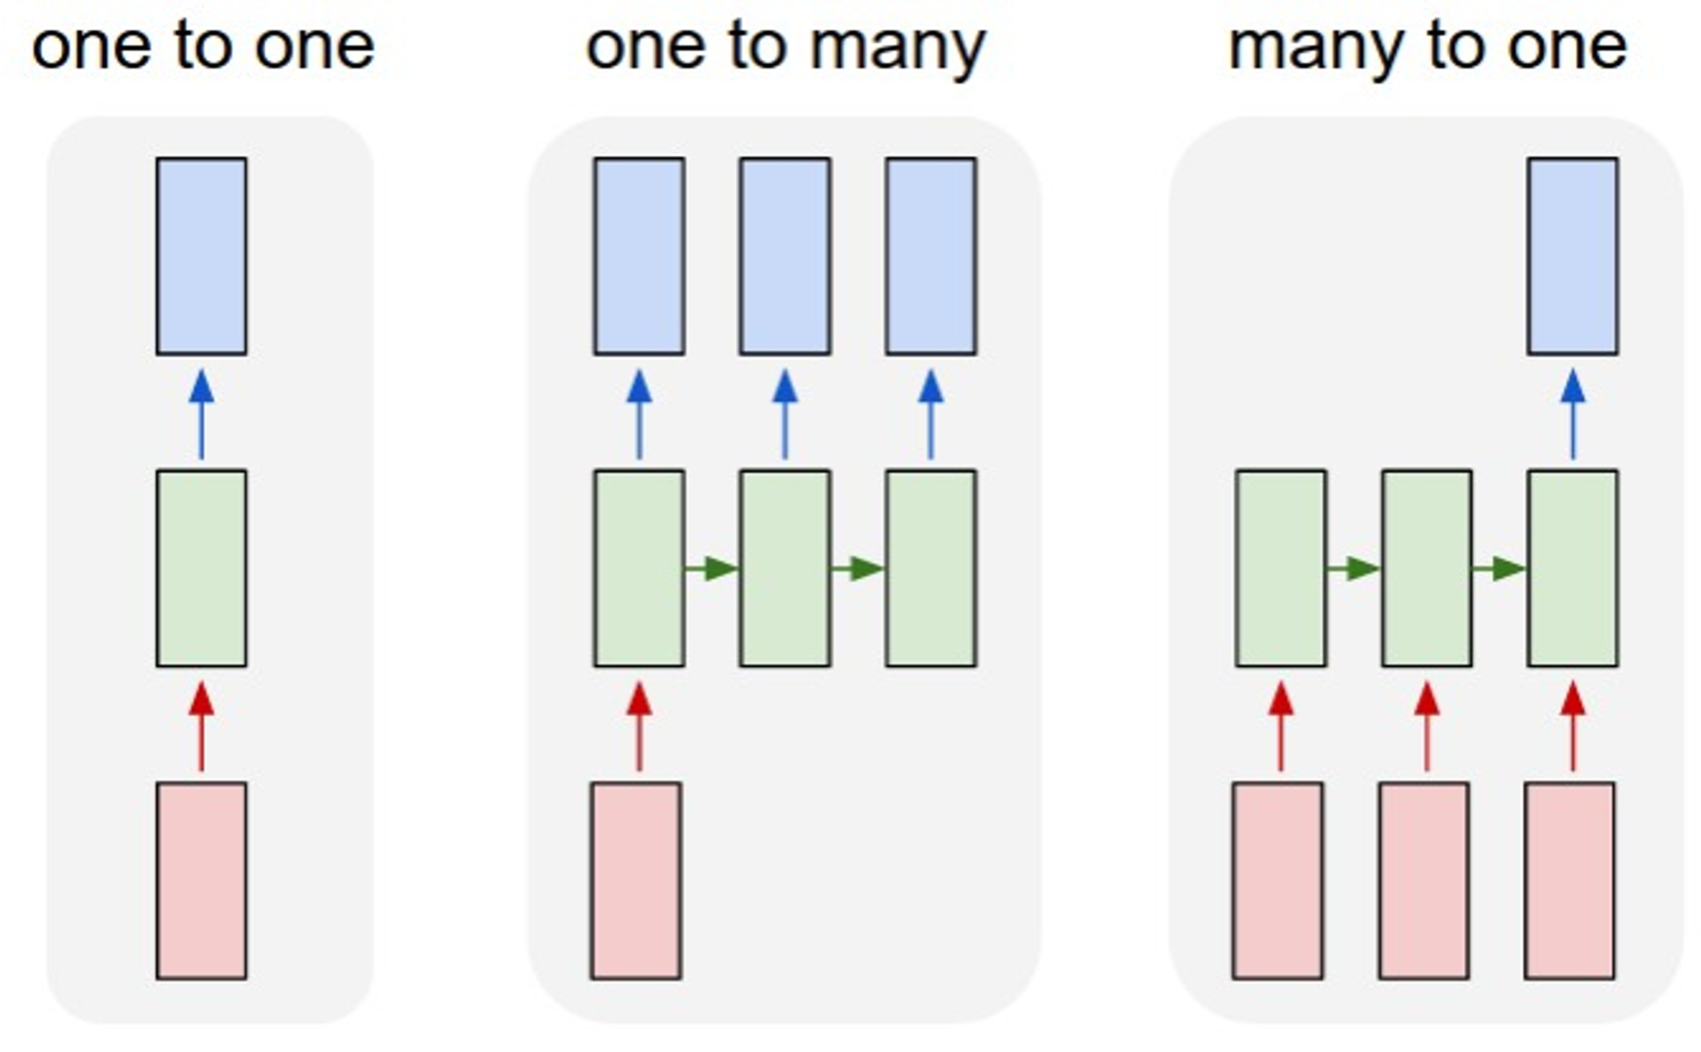
Recurrent Neural Networks: Process Sequences
e.g. Video classification:
Sequence of images -> label
Notes:
Many to one example: set of frames from a video → we want to predict what is happening (label what is happening).
Another example: sequence of genes predict if a person has cancer or some other illness.

Slide 6
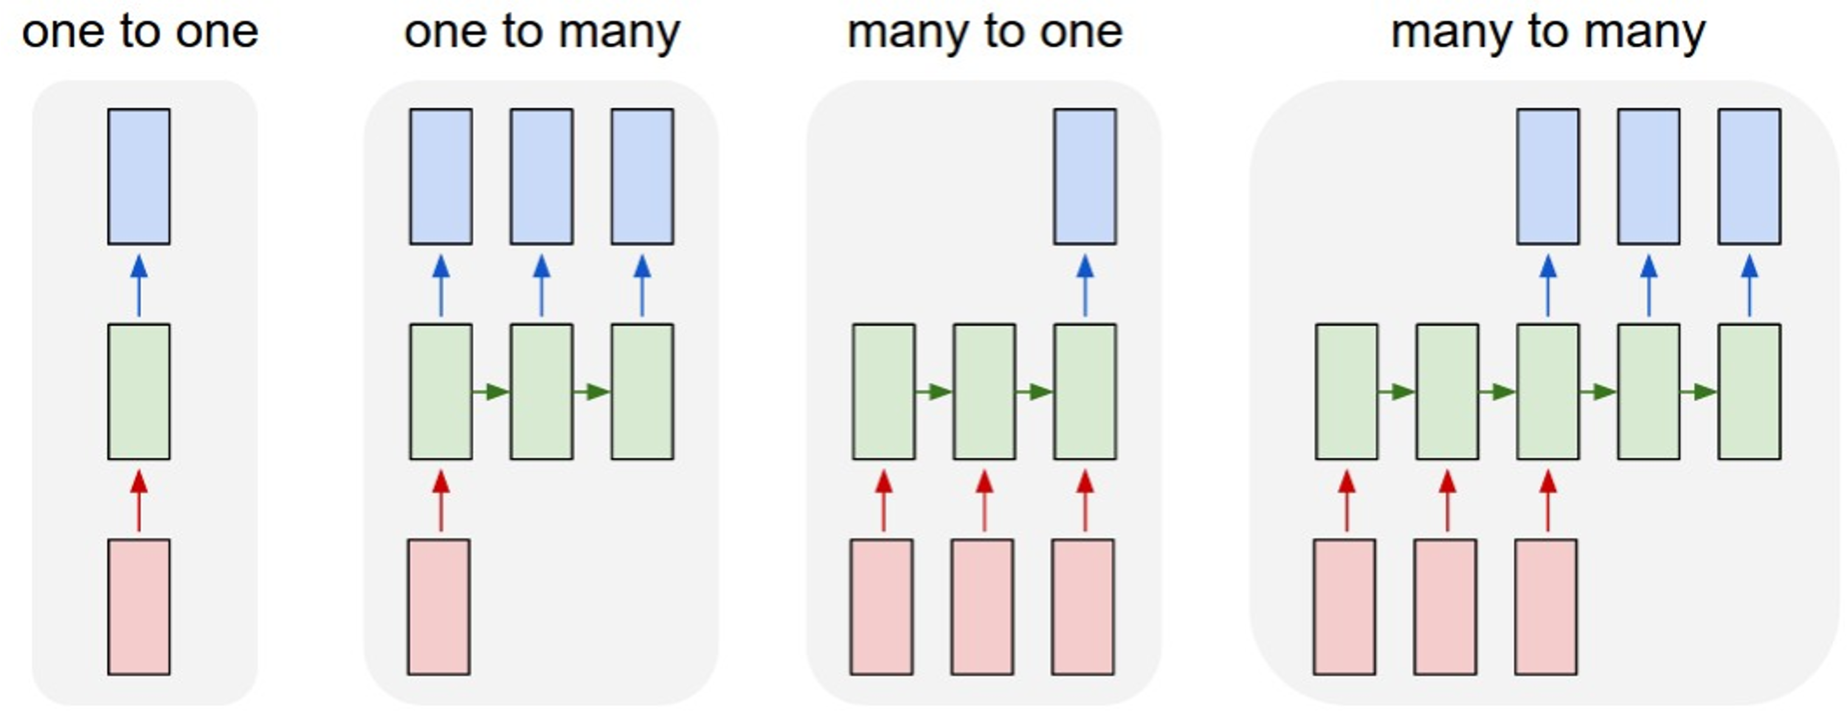
Recurrent Neural Networks: Process Sequences
e.g. Machine Translation:
Sequence of words -> Sequence of words
Notes:
Example of machine translation: compilers, assemblers, interpreters, translation form English to Spanish, etc.
Note: often length of output and input is often different, i.e. c code is much smaller than the output assembly code generated by the compiler doing the translation.

Slide 7
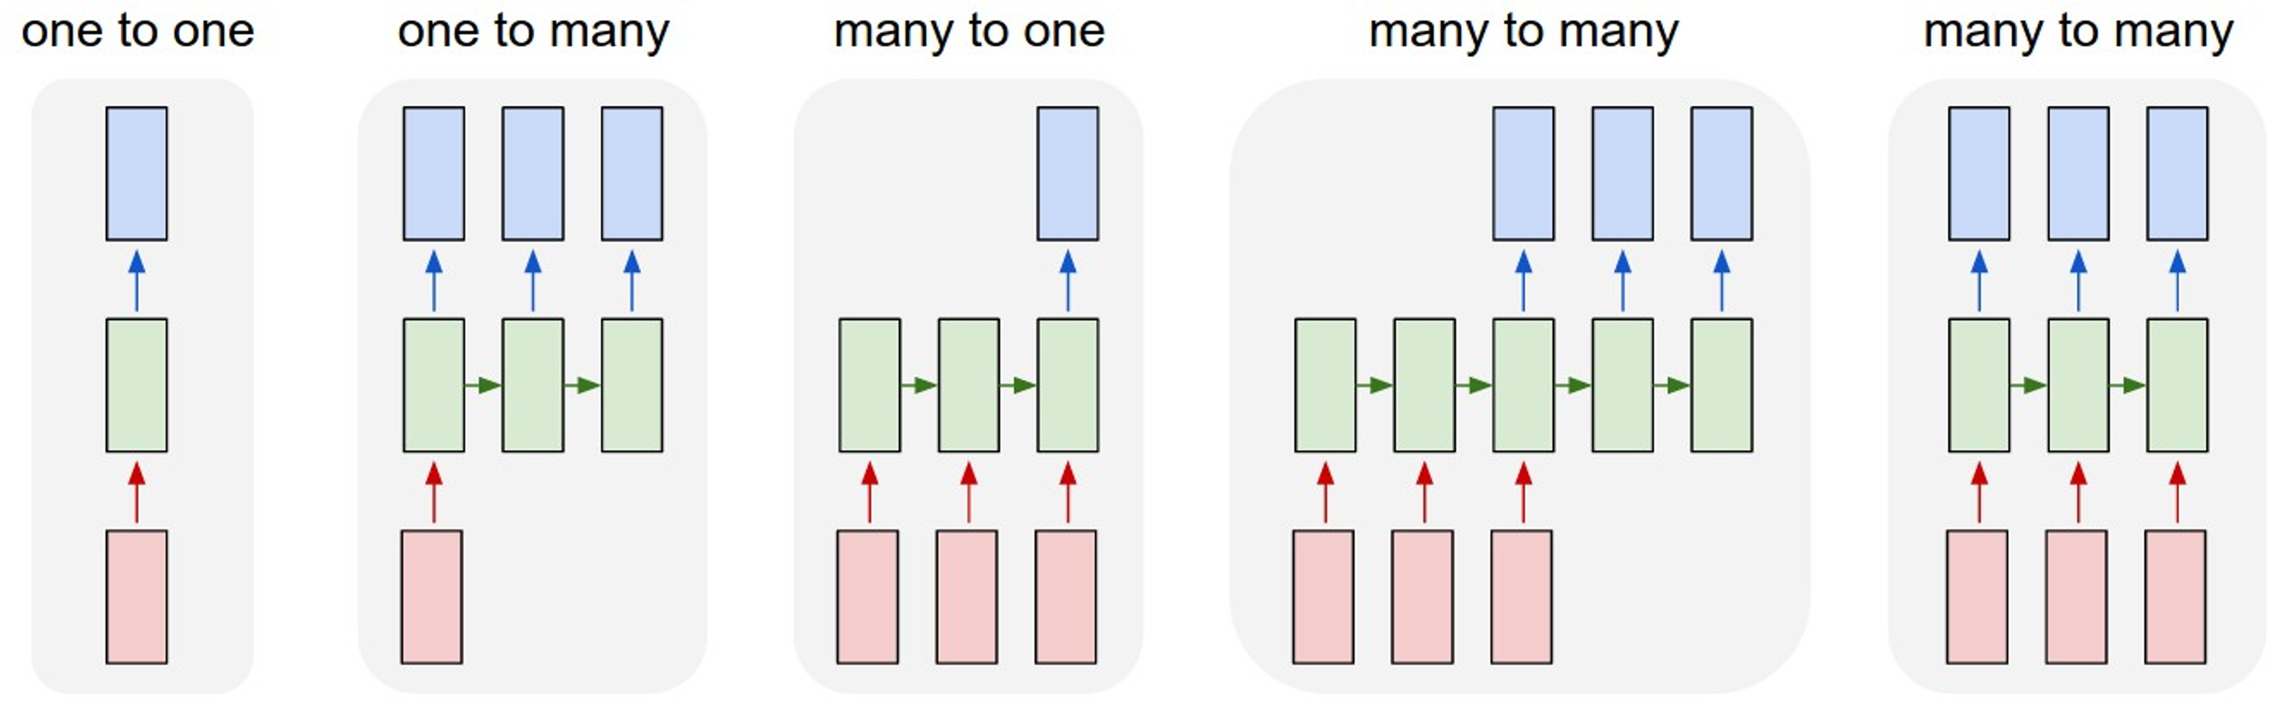
Recurrent Neural Networks: Process Sequences
e.g. Per-frame video classification:
Sequence of images -> Sequence of labels
Notes:
Another example: take frames from a video and output a sentence about what is happening (not merely a label to represent what is happening, like many to one).
Another example: predict what report to output based on what is currently happening (video frames) in a basketball game.
With many to many, we can work with sequence of input and get a sequence of output.
Note: whenever you have x to many, you need to use recurrence since it involves several nodes that depend on each other for predicting the full sequence of an output in the model.
We can also use many to many to allow arbitrary input lengths (each input in the input sequence could be a different size image for example), allowing for flexibility and not having to always deal with only a single fixed length of input.

Slide 8
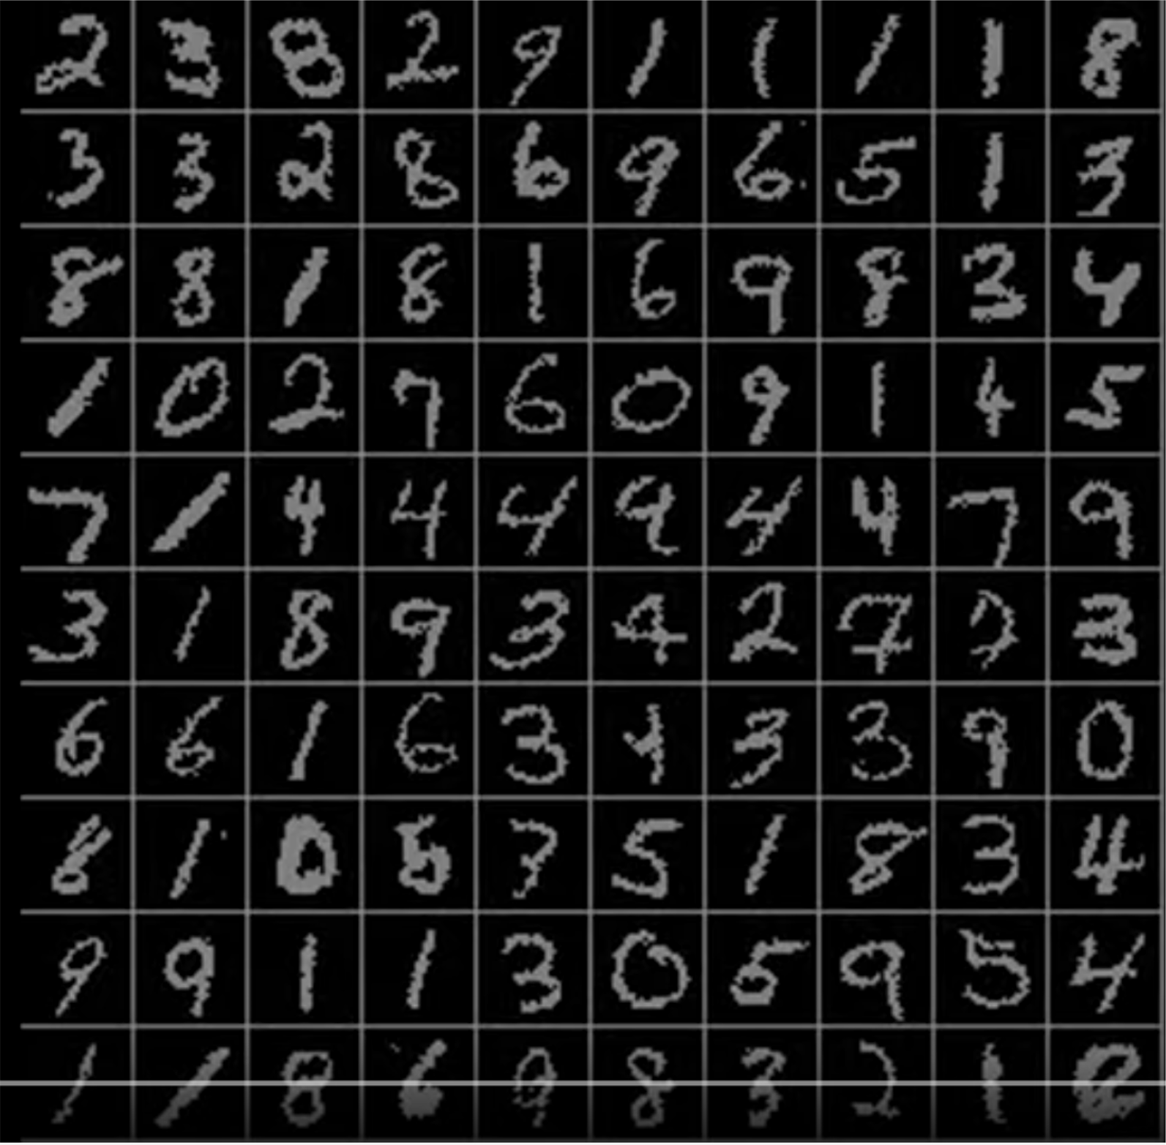
Sequential Processing of Non-Sequential Data
Classify images by taking a series of “glimpses”
Ba, Mnih, and Kavukcuoglu, “Multiple Object Recognition with Visual Attention”, ICLR 2015.
Gregor et al, “DRAW: A Recurrent Neural Network For Image Generation”, ICML 2015
Notes:
Above, showing how you can take a nonsequential problem and make it sequential and use Recurrent Neural Network that can take multiple glimpses of several images (for example, an entire row above would be a row of images that would be a sequence input into the model, and by training sequences, you can effectively extract the class for all digits).

Slide 9
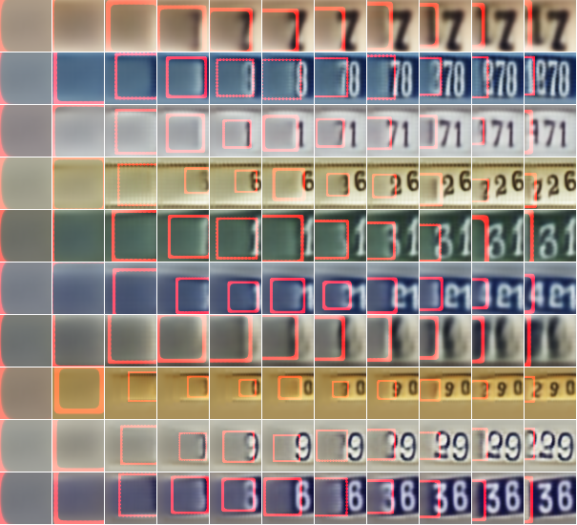
Sequential Processing of Non-Sequential Data
Generate images one piece at a time!
Gregor et al, “DRAW: A Recurrent Neural Network For Image Generation”, ICML 2015
Notes:
Image is appended left to right by the model.
Red boxes is where the model will target to write a digit.
This is a generative process model.

Slide 10
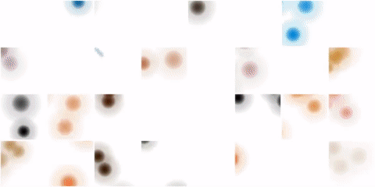
Sequential Processing of Non-Sequential Data
Integrate with oil paint simulator – at each timestep output a new stroke
Ganin et al, “Synthesizing Programs for Images using Reinforced Adversarial Learning”, ICML 2018 https://twitter.com/yaroslav_ganin/status/1180120687131926528
Reproduced with permission
Notes:
Each time step uses the output from the previous time step = recurrence!

Slide 11
Recurrent Neural Networks
y
Key idea: RNNs have an “internal state” that is updated as a sequence is processed
RNN
x
Notes:
x=input
Y=output

Slide 12
Recurrent Neural Networks
y
We can process a sequence of vectors x by applying a recurrence formula at every time step:
ℎ_{t} = 𝑓_{W} ℎ_{t-1}, 𝑥_{t}
RNN
new state old state
some function with parameters W
input vector at some time step
x
Notes:
h=hidden state

Slide 13
Recurrent Neural Networks
Notice: the same function and the same set of parameters are used at every time step.
y
We can process a sequence of vectors x by applying a recurrence formula at every time step:
ℎ_{t} = 𝑓_{w} ℎ_{t-1}, 𝑥_{t}
RNN
new state old state
some function with parameters W
input vector at some time step
x
Notes:
Notice w (weight matrix) is used at every time stamp of the sequence (i.e. for all h_t).

Slide 14
(Vanilla) Recurrent Neural Networks
The state consists of a single “hidden” vector h:
ℎ_{t} = 𝑓_{w} ℎ_{t-1}, 𝑥_{t}
y
RNN
ℎ_{t} = tanh 𝑊_{hh}ℎ_{t-1}+ 𝑊_{xh} 𝑥_{t}
𝑦_{t} = 𝑊_{hy}ℎ_{t}
Sometimes called a “Vanilla RNN” or an “Elman RNN” after Prof. Jeffrey Elman
x
Notes:
We can add a bias term b in the tanh function.
f = tanh (hyperbolic tangent), which is our activation function.
w= parameters of f = W_hh, W_hy, W_hx
W_hy is the W_hy matrix of size hxy, etc.
We want to learn W_hy, W_xh, and W_hh

Slide 15
RNN Computational Graph
Initial hidden state Either set to all 0, Or learn it
h₀
x₁

Slide 16
RNN Computational Graph
h₀
h₁
f_{W}
x₁

Slide 17
RNN Computational Graph
h₀
h₁
h₂
f_{W}
f_{W}
x₁
x₂

Slide 18
RNN Computational Graph
h₀
h₁
h₂
h₃
…
h_{T}
f_{W}
f_{W}
f_{W}
x₁
x₂
x₃
Notes:
Run model through final node T to make final prediction.
Don’t forget back propagation occurs to update the weights W_hh W_xh and W_hy

Slide 19
RNN Computational Graph
Re-use the same weight matrix at every time-step
h₃
…
h_{T}
h₀
f_{W}
h₁
f_{W}
h₂
f_{W}
x₁
x₂
x₃
W
Notes:
W = the eight matrix, used for all function fw
W is th matrix [W_hy, W_xh, W_hh]

Slide 20
RNN Computational Graph (Many to Many)
y₁
y₂
y₃
y_{T}
h₃
…
h_{T}
h₀
f_{W}
h₁
f_{W}
h₂
f_{W}
x₁
x₂
x₃
W

Slide 21
RNN Computational Graph (Many to Many)
y₁
y₂
y₃
y_{T}
L₁
L₂
L₃
L_{T}
h₃
…
h_{T}
h₀
f_{W}
h₁
f_{W}
h₂
f_{W}
x₁
x₂
x₃
W
Notes:
L = loss

Slide 22
RNN Computational Graph (Many to Many)
L
y₁
L₁
y₂
L₂
y₃
L₃
y_{T}
L_{T}
h₃
…
h_{T}
h₀
f_{W}
h₁
f_{W}
h₂
f_{W}
x₁
x₂
x₃
W
Notes:
Big L is sum of all loss functions L_n

Slide 23
RNN Computational Graph (Many to One)
y
h₃
…
h_{T}
h₀
f_{W}
h₁
f_{W}
h₂
f_{W}
x₁
x₂
x₃
W

Slide 24
RNN Computational Graph (One to Many)
y₁
y₂
y₃
y_{T}
h₃
…
h_{T}
h₀
f_{W}
h₁
f_{W}
h₂
f_{W}
x
W

Slide 25
Sequence to Sequence (seq2seq) (Many to one) + (One to many)
Many to one: Encode input sequence in a single vector
h₃
…
h_{T}
h₀
f_{W}
h₁
f_{W}
h₂
f_{W}
x₁
x₂
x₃
W₁
Sutskever et al, “Sequence to Sequence Learning with Neural Networks”, NIPS 2014

Slide 26
Sequence to Sequence (seq2seq) (Many to one) + (One to many)
One to many: Produce output sequence from single input vector
Many to one: Encode input sequence in a single vector
y₁
y₂
h₃
…
h_{T}
…
h₀
f_{W}
h₁
f_{W}
h₂
f_{W}
f_{W}
h₁
f_{W}
h₂
f_{W}
x₁
x₂
x₃
W₁
W₂
Sutskever et al, “Sequence to Sequence Learning with Neural Networks”, NIPS 2014

Slide 27
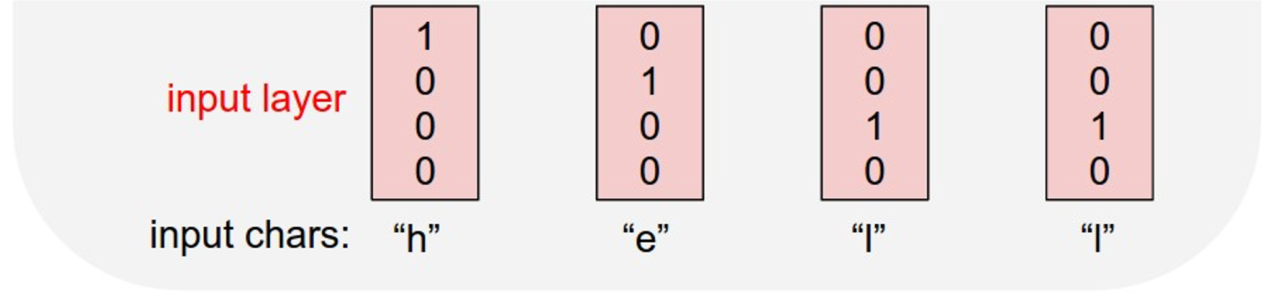
Example: Language Modeling
Given characters 1, 2, …, t-1, model predicts character t
Training sequence: ”hello” Vocabulary: [h, e, l, o]

Slide 28
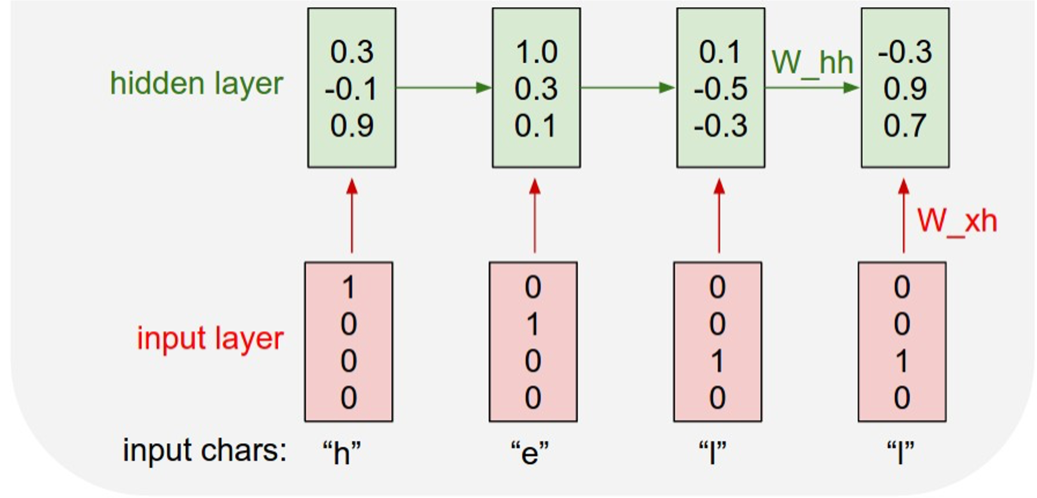
Example: Language Modeling
Given characters 1, 2, …, t-1, model predicts character t
Training sequence: ”hello” Vocabulary: [h, e, l, o]

Slide 29
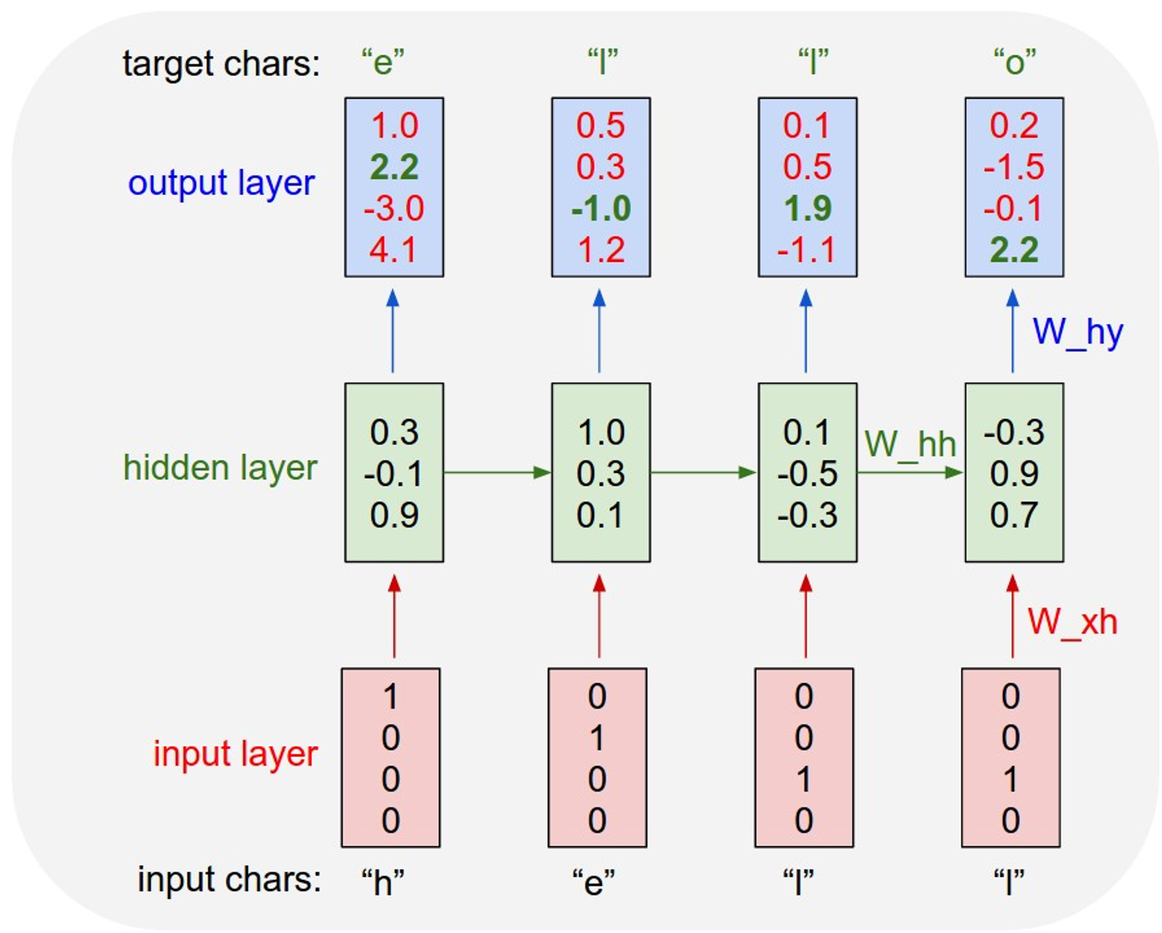
Example: Language Modeling
Given characters 1, 2, …, t-1, model predicts character t
Training sequence: ”hello” Vocabulary: [h, e, l, o]

Slide 30
Example: Language Modeling
Given “h”, predict “e”
Given characters 1, 2, …, t-1, model predicts character t
Training sequence: ”hello” Vocabulary: [h, e, l, o]

Slide 31
Example: Language Modeling
Given “he”, predict “l”
Given characters 1, 2, …, t-1, model predicts character t
Training sequence: ”hello” Vocabulary: [h, e, l, o]

Slide 32
Example: Language Modeling
Given “hel”, predict “l”
Given characters 1, 2, …, t-1, model predicts character t
Training sequence: ”hello” Vocabulary: [h, e, l, o]

Slide 33
Example: Language Modeling
Given “hell”, predict “o”
Given characters 1, 2, …, t-1, model predicts character t
Training sequence: ”hello” Vocabulary: [h, e, l, o]

Slide 34
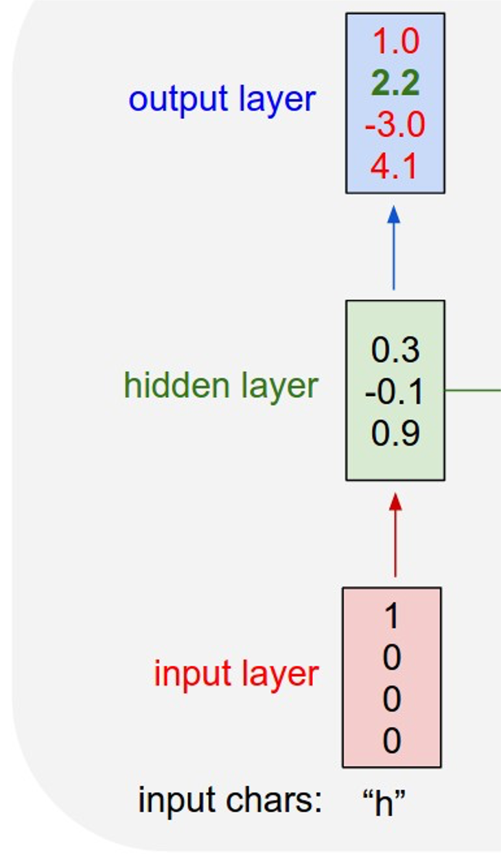
Example: Language Modeling
“e
Sample
”
.03
.13
.00
.84
Softmax
At test-time, generate new text: sample characters one at a time, feed back to model
Training sequence: ”hello” Vocabulary: [h, e, l, o]

Slide 35
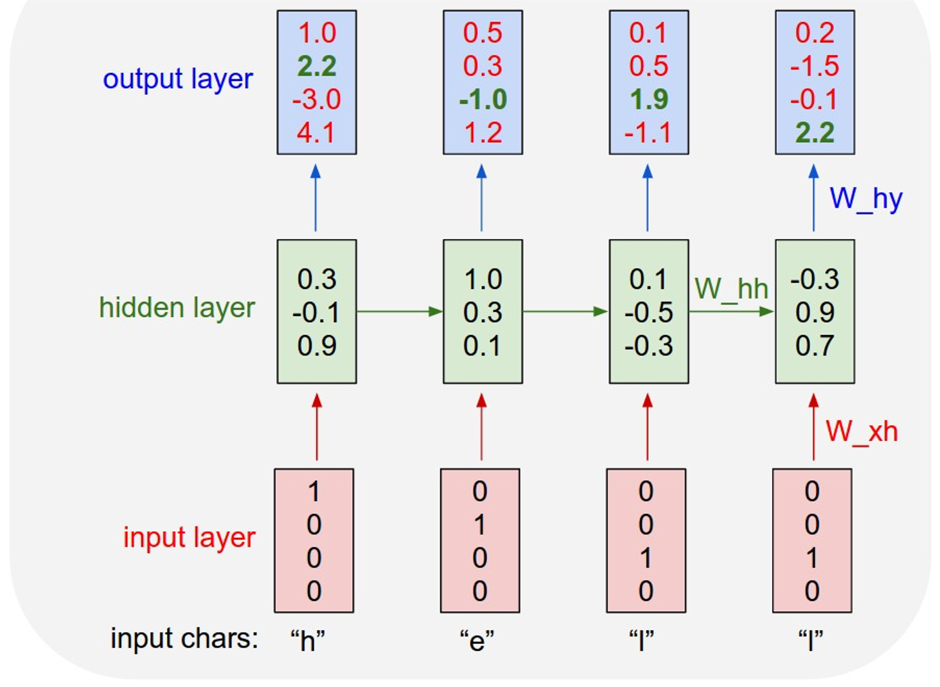
Example: Language Modeling
“e
Sample
”
.03
.13
.00
.84
Softmax
At test-time, generate new text: sample characters one at a time, feed back to model
Training sequence: ”hello” Vocabulary: [h, e, l, o]

Slide 36
Example: Language Modeling
“e
“l
Sample
”
”
.03
.13
.00
.84
.25
.20
.05
.50
Softmax
At test-time, generate new text: sample characters one at a time, feed back to model
Training sequence: ”hello” Vocabulary: [h, e, l, o]

Slide 37
Example: Language Modeling
“e | “l “l “o
” .03 |  | .25 |  | .1”1 |  | ” .11
.13 |  | .20 |  | .17 |  | .02
.00 |  | .05 |  | .68 |  | .08
.84 |  | .50 |  | .03 |  | .79
Sample
”
Softmax
At test-time, generate new text: sample characters one at a time, feed back to model
Training sequence: ”hello” Vocabulary: [h, e, l, o]
Notes:
WE ARE LOOKING AT A MARKOV CHAIN: SYSTEM WILL CONVERGE ; BUT IT WILL NOT BECAUSE WE USE ACTIVATION FUNCTION TO MAKE SURE SYSTEM IS NO LONGER A LINEAR SYSTEM.

Slide 38
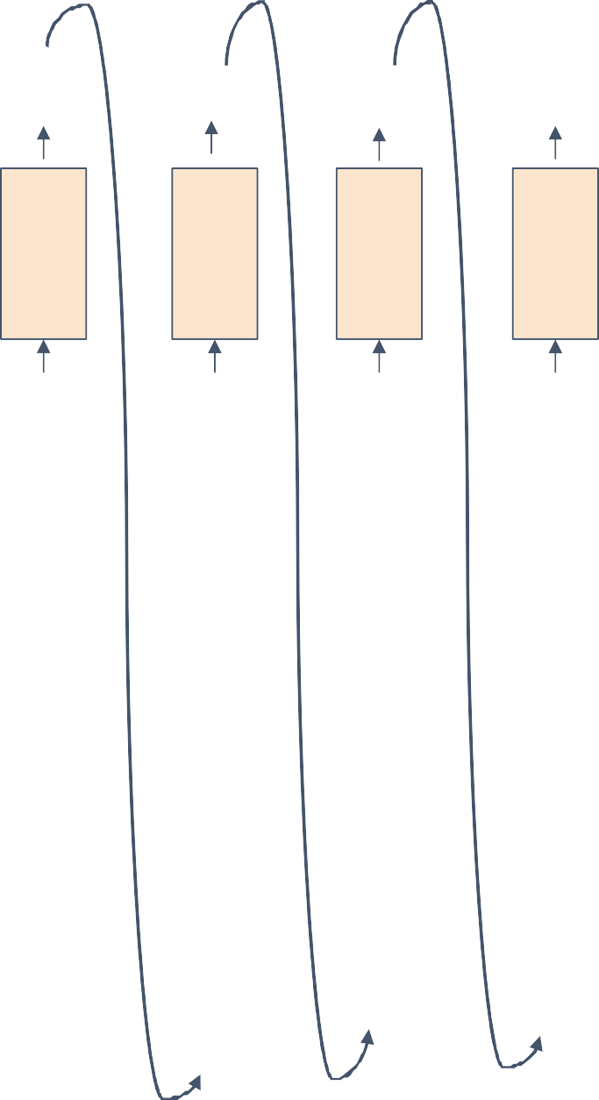
Example: Language Modeling
“e | “l “l “o
” | ” | ” | ” .11
.13 | .20 | .17 | .02
.00 | .05 | .68 | .08
.84 | .50 | .03 | .79
Sample
So far: encode inputs as one-hot-vector
.03
.25
.11
Softmax
[w₁₁ w₁₂ w₁₃ w₁₄] [1] [w₁₁] [w₂₁ w₂₂ w₂₃ w₁₄] [0] = [w₂₁] [w₃₁ w₃₂ w₃₃ w₁₄] [0] [w₃₁]
[0]
Matrix multiply with a one-hot vector just extracts a column from the weight matrix. Often extract this into a separate embedding layer (to avoid unnecessary multiplication operations)

Slide 39
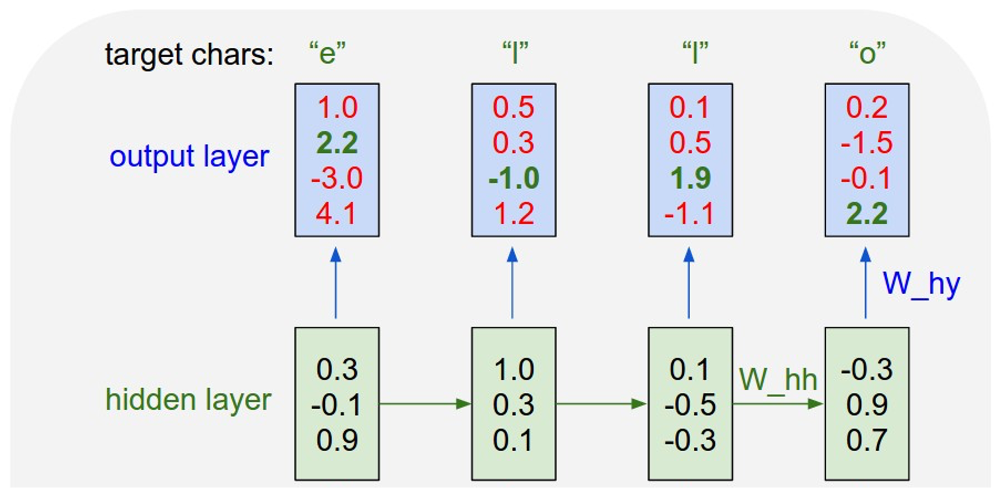
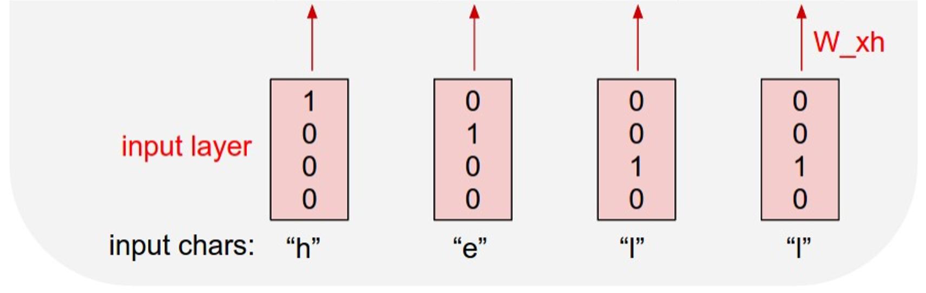
Example: Language Modeling
So far: encode inputs as one-hot-vector
[w₁₁ w₁₂ w₁₃ w₁₄] [1] [w₁₁]
[w₂₁ w₂₂ w₂₃ w₁₄] [0] = [w₂₁] [w₃₁ w₃₂ w₃₃ w₁₄] [0] [w₃₁]
[0]
Matrix multiply with a one-hot vector just extracts a column from the weight matrix. Often extract this into a separate embedding layer
.03
.13
.00
.84
.25
.20
.05
.50
.11
.17
.68
.03
.11
.17
.68
.03
Embedding
layer

Slide 40
Backpropagation Through Time
Forward through entire sequence to compute loss, then backward through entire sequence to compute gradient
Loss

Slide 41
Backpropagation Through Time
Forward through entire sequence to compute loss, then backward through entire sequence to compute gradient
Problem: Takes a lot of memory for long sequences!
Loss

Slide 42
Truncated Backpropagation Through Time
Loss
Run forward and backward through chunks of the sequence instead of whole sequence;
Saves memory but sacrifices accuracy.

Slide 43
Truncated Backpropagation Through Time
Loss
Carry hidden states forward in time forever, but only backpropagate for some smaller number of steps

Slide 44
Truncated Backpropagation Through Time
Loss
Notes:
Make truncation as long as possible (as your system can handle ) so as to reduce accuracy lost.

Slide 45
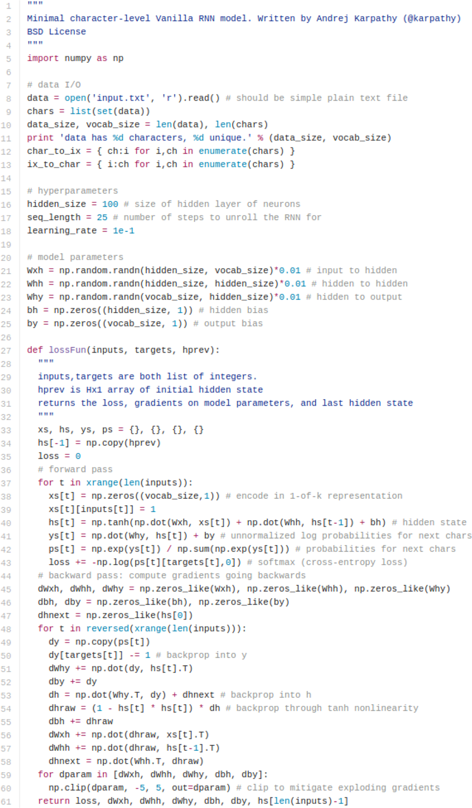
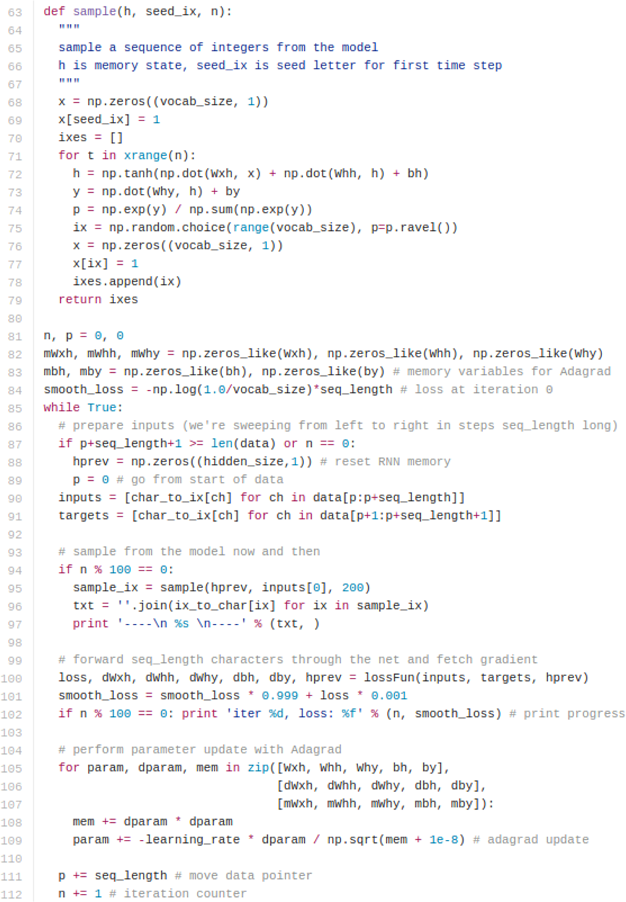
min-char-rnn.py: 112 lines of Python
(https://gist.github.com/karp athy/d4dee566867f8291f086)

Slide 46
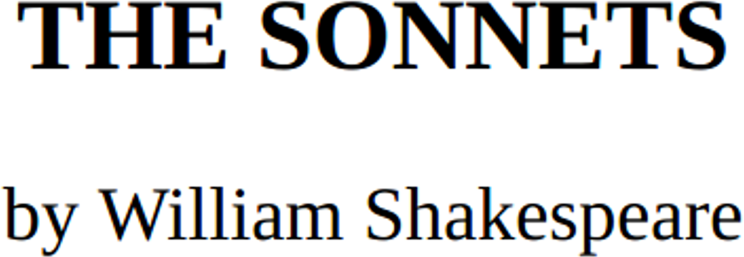
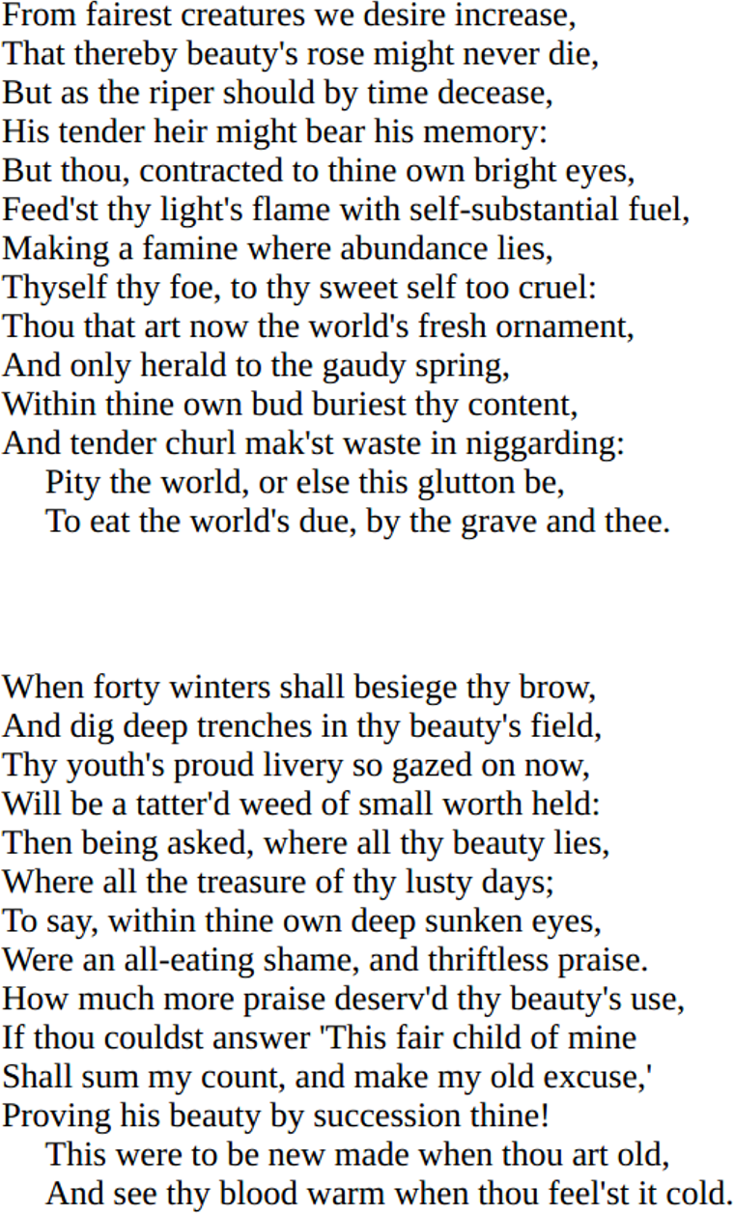
y
RNN
x
Notes:
Recursively feed the poem (same data) into the RNN

Slide 47
at first:

Slide 48
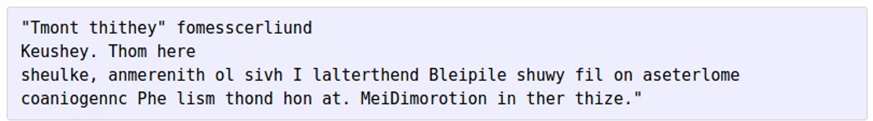
at first:
train more

Slide 49
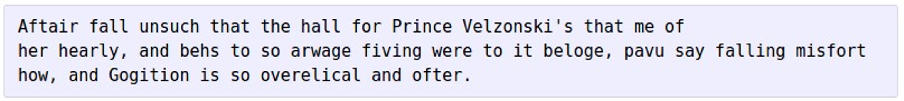
at first:
train more
train more

Slide 50
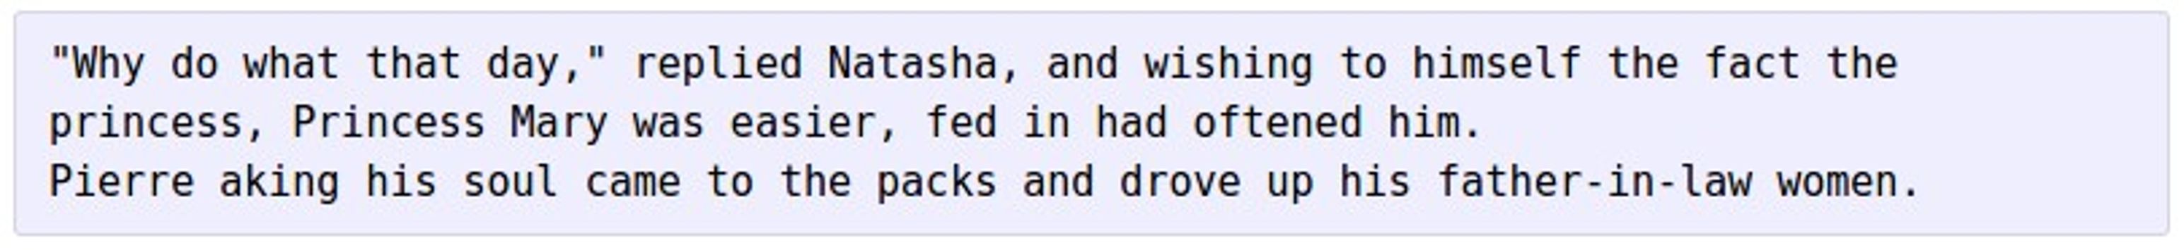
at first:
train more
train more
train more

Slide 51
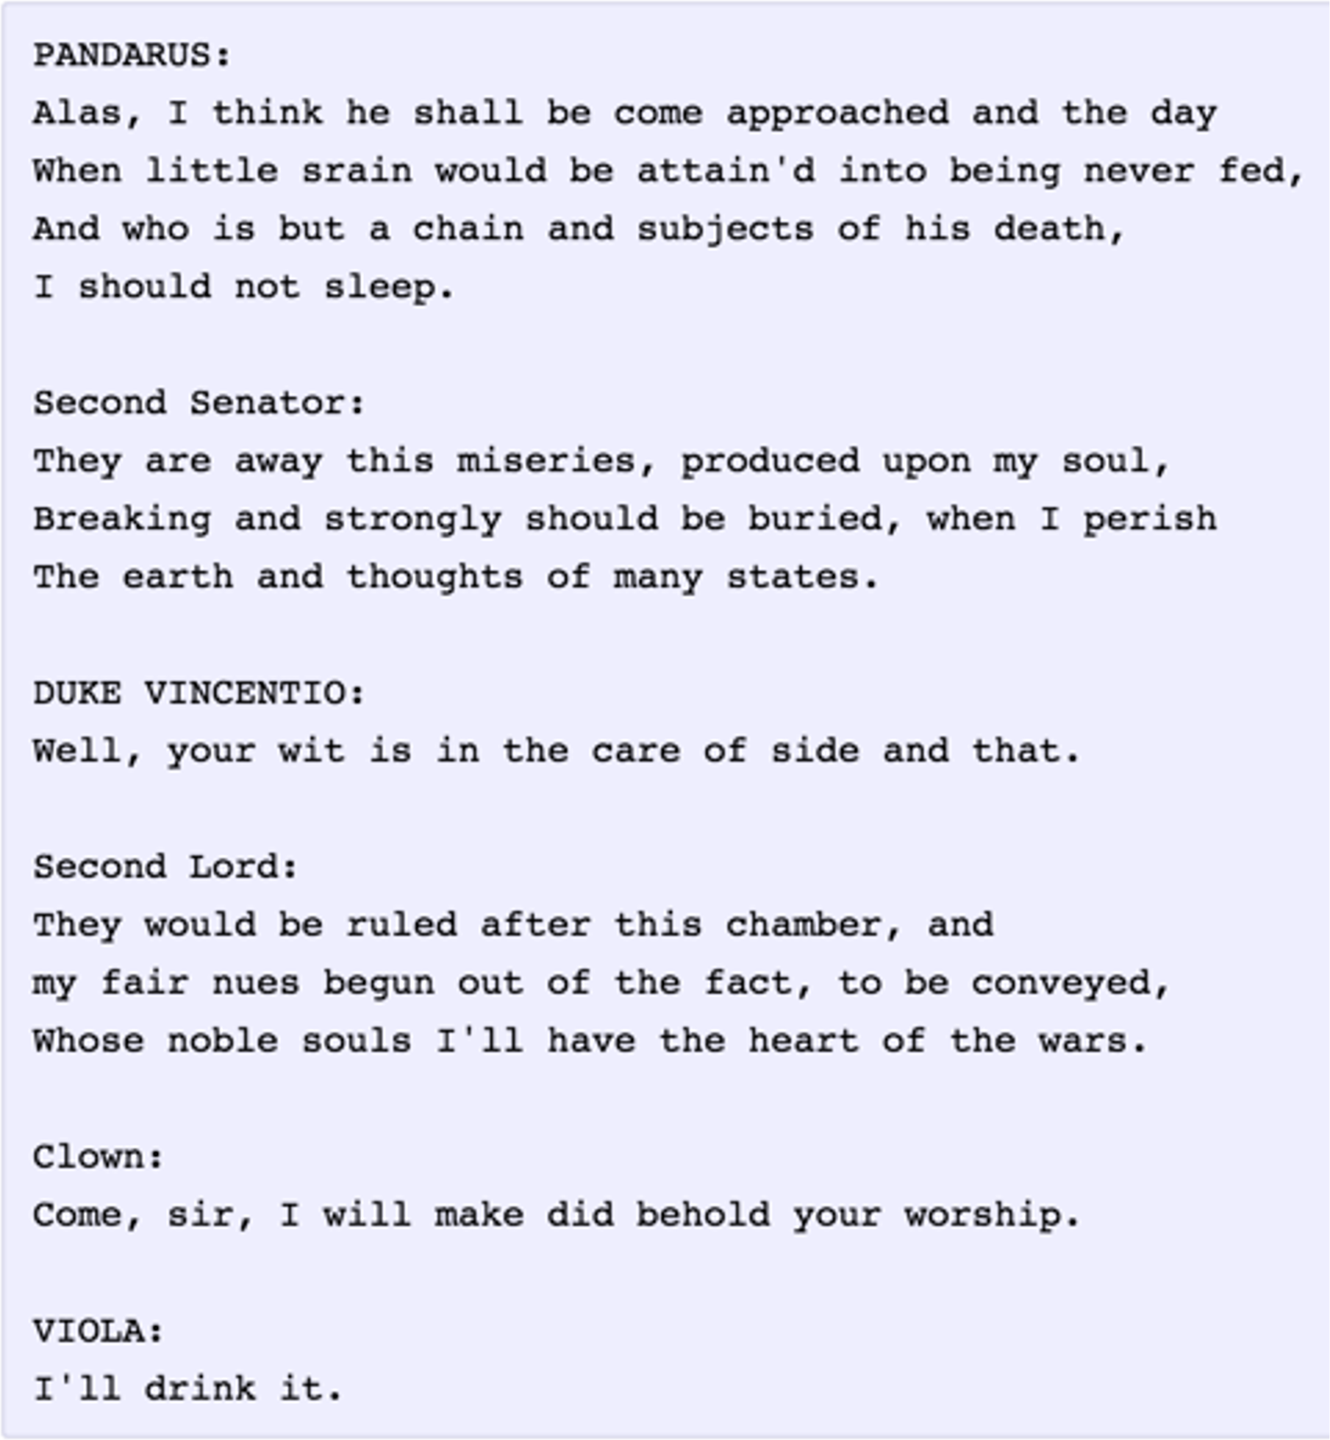
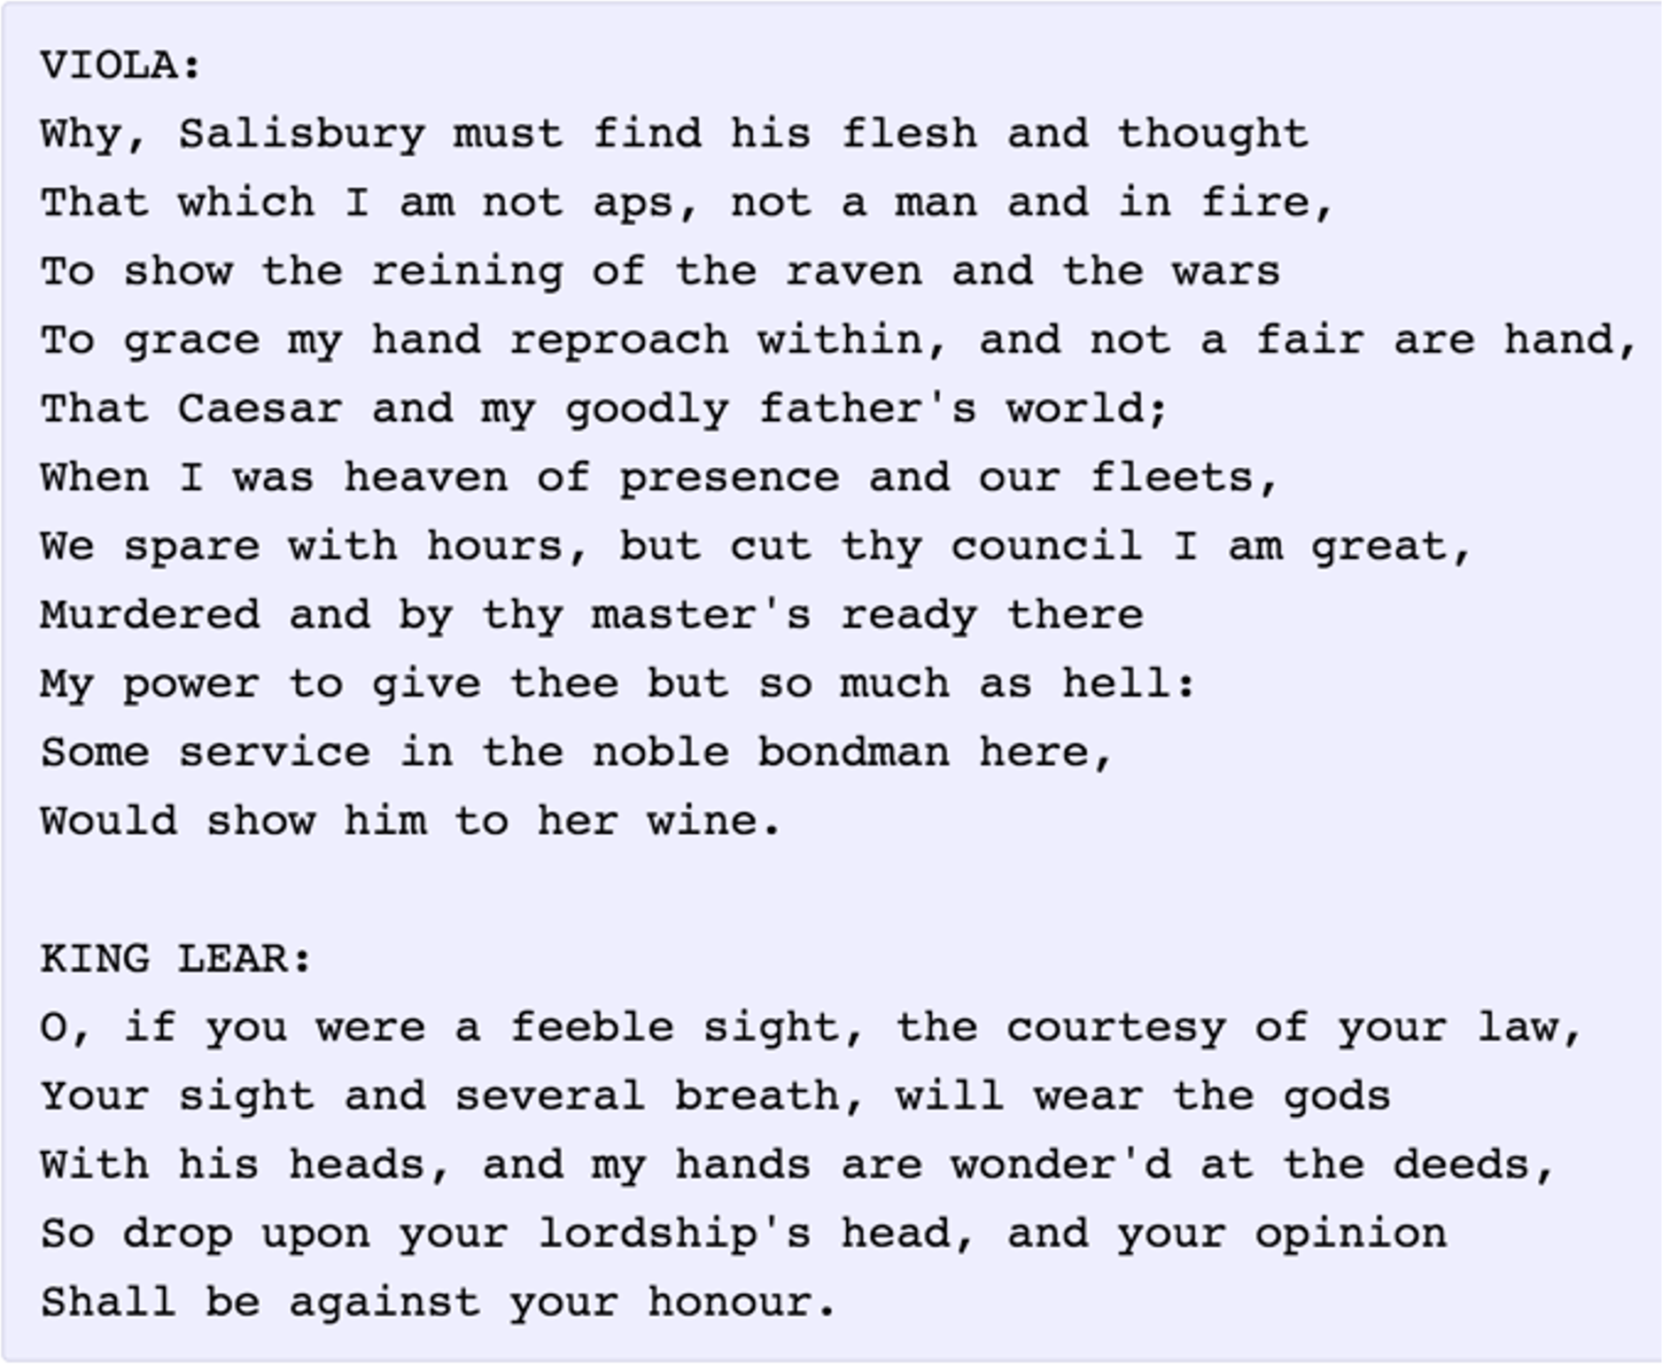

Slide 52
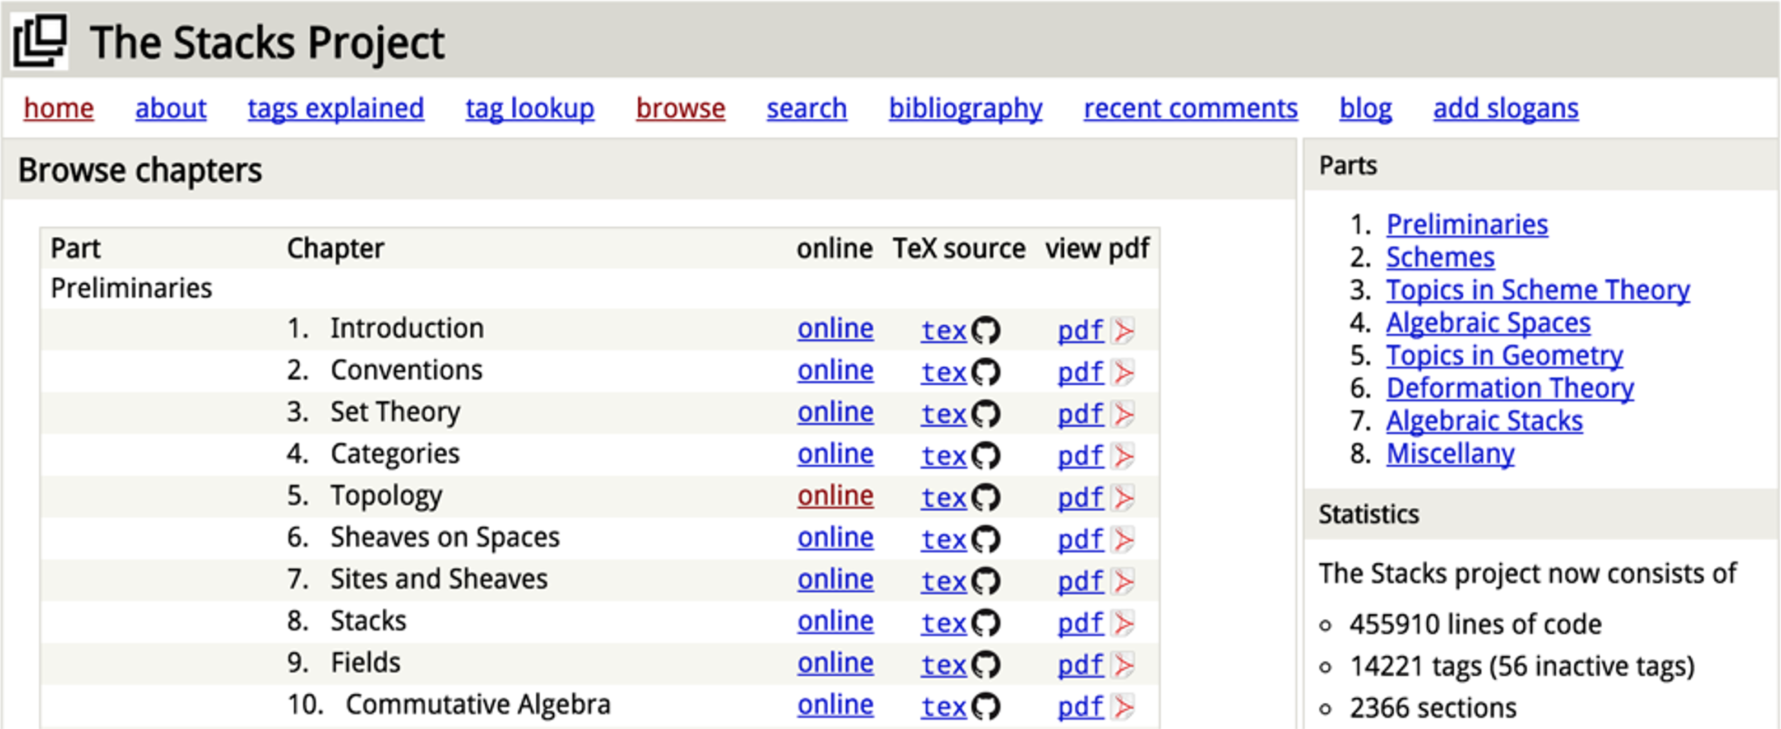
The Stacks Project: Open-Source Algebraic Geometry Textbook
Latex source
http://stacks.math.columbia.edu/
The stacks project is licensed under the GNU Free Documentation License

Slide 53
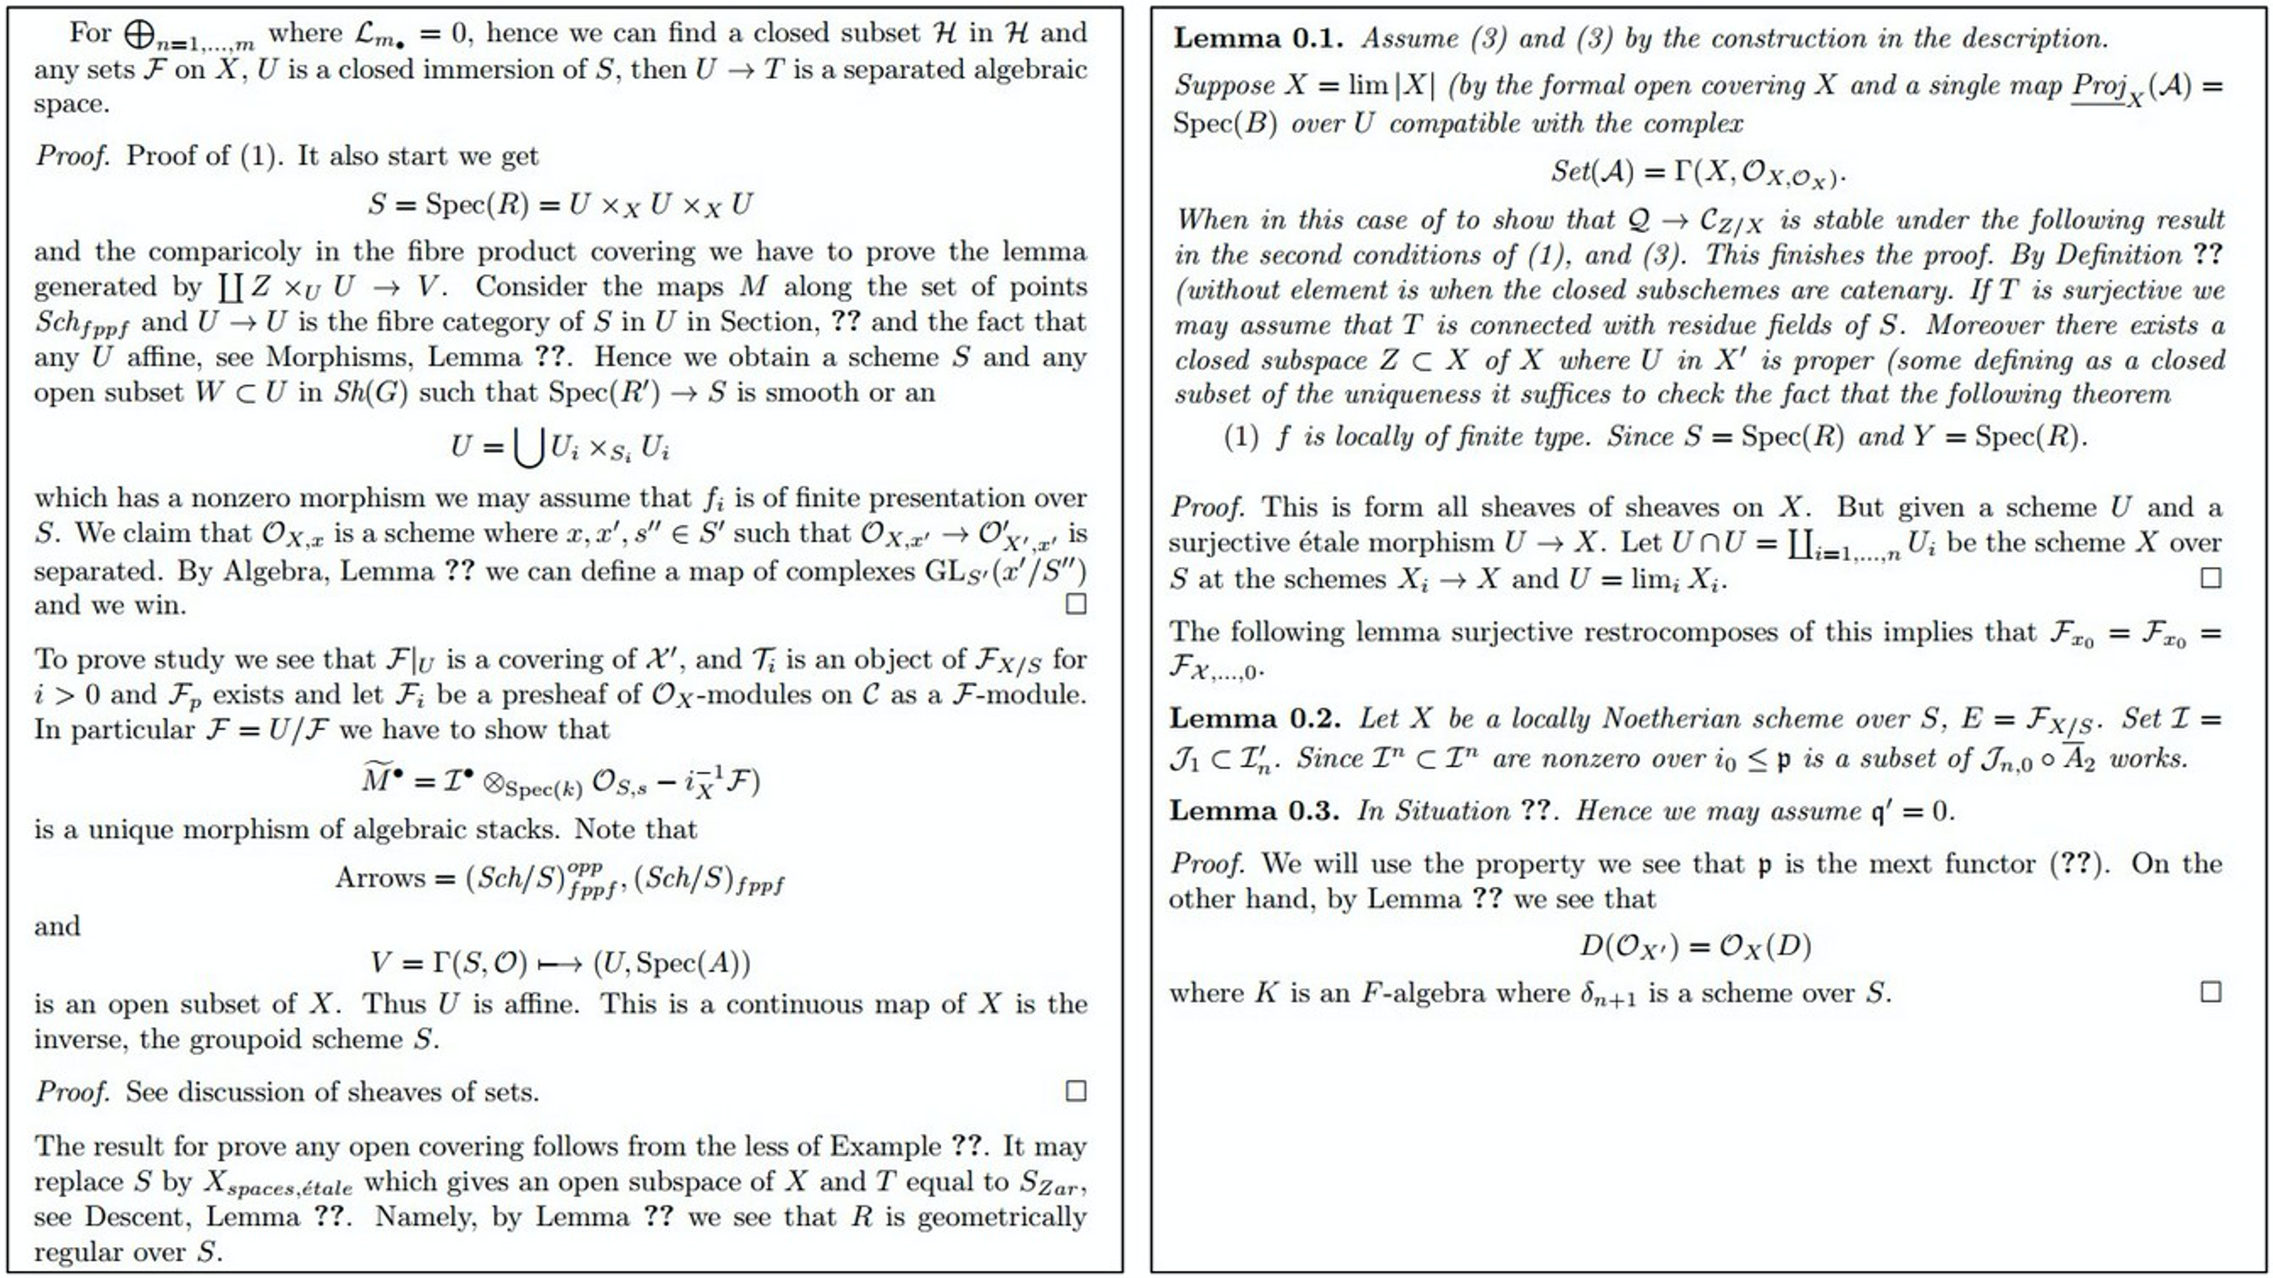

Slide 54
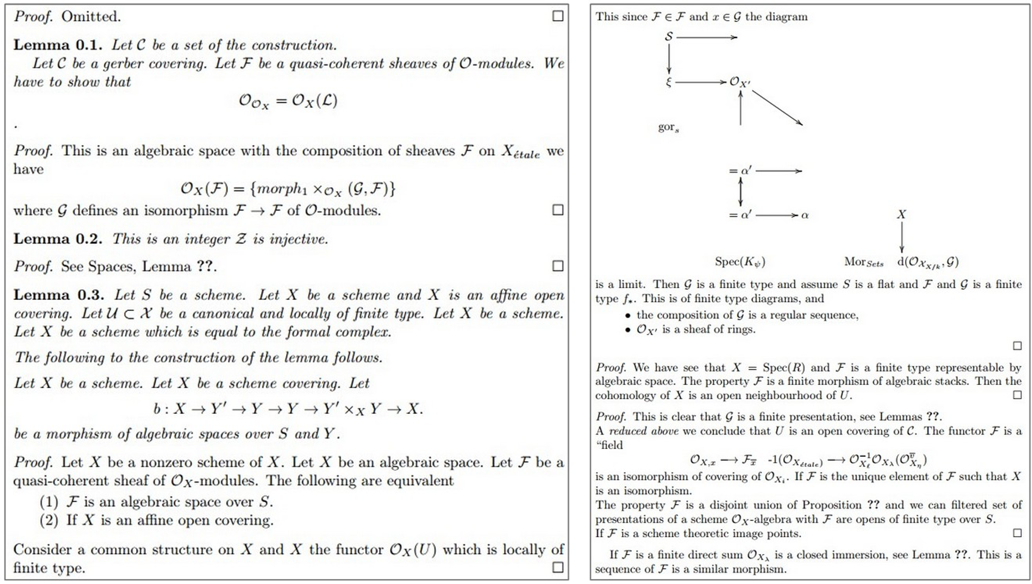

Slide 55


Slide 56
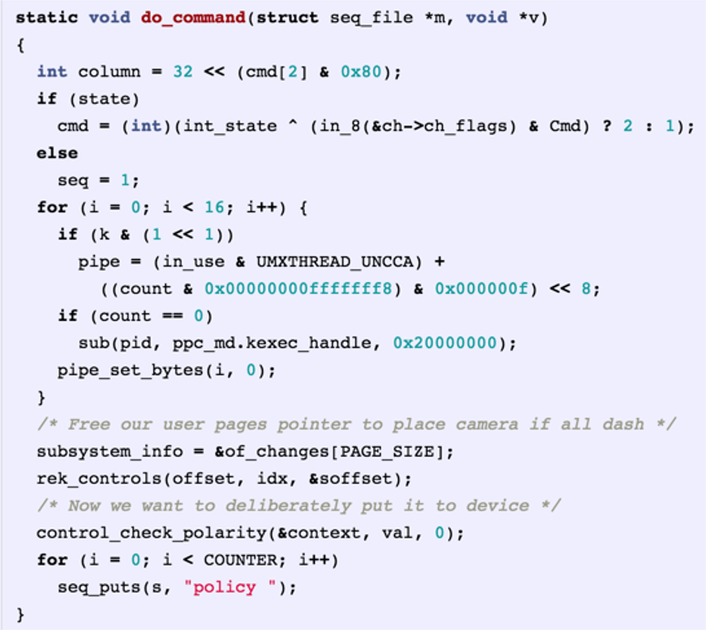
Generated C code

Slide 57
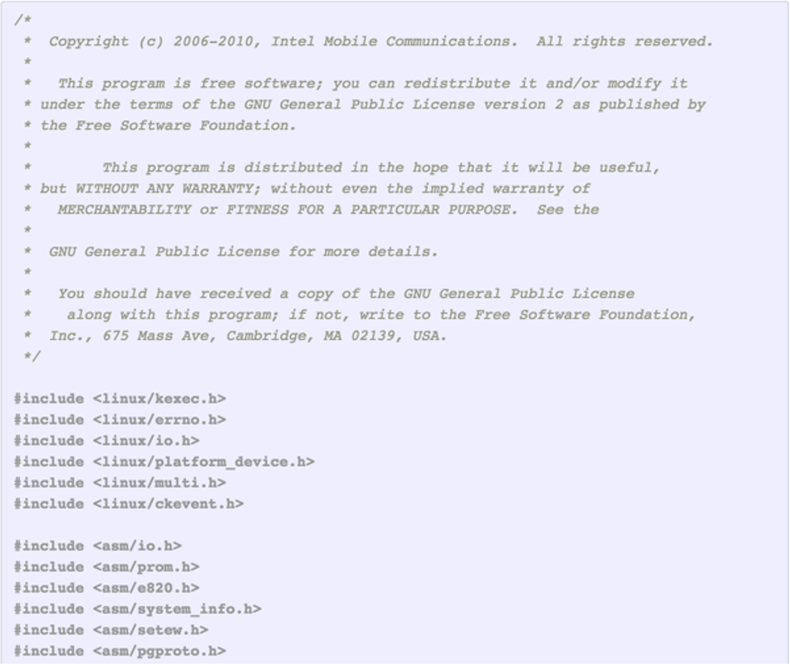

Slide 58
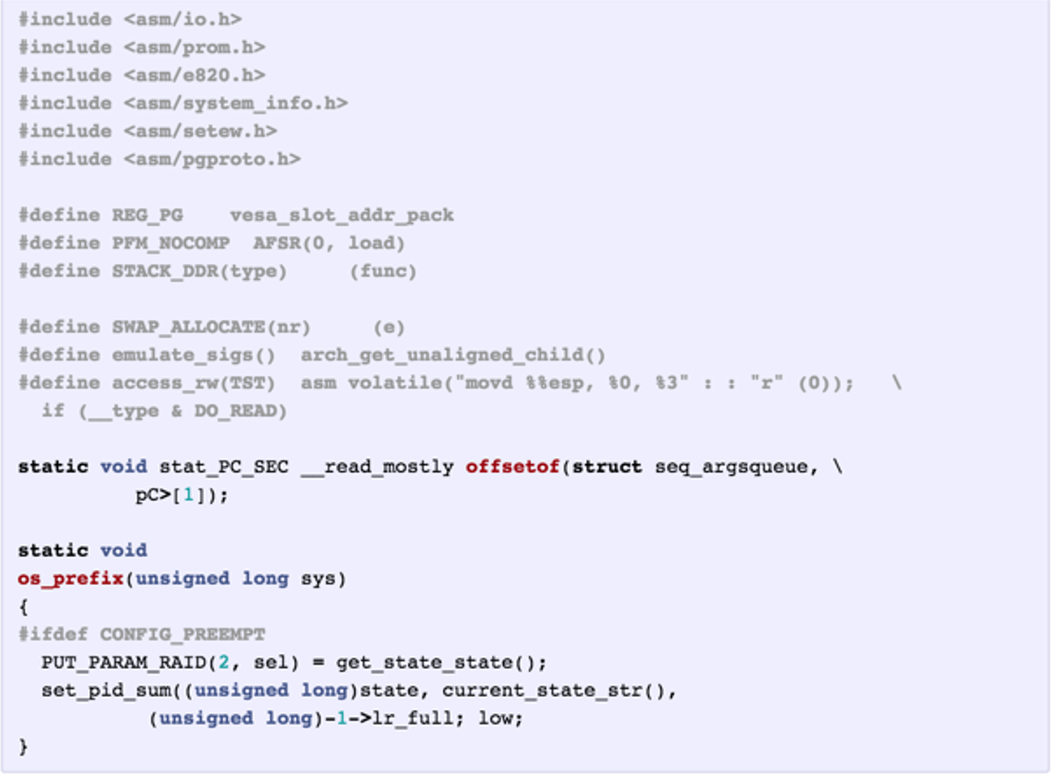

Slide 59
Searching for Interpretable Hidden Units
Karpathy, Johnson, and Fei-Fei: Visualizing and Understanding Recurrent Networks, ICLR Workshop 2016
Notes:
Natural language processing is how Visual Studio works to predict what you will finish typing.

Slide 60
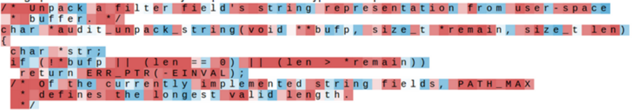
Searching for Interpretable Hidden Units
Karpathy, Johnson, and Fei-Fei: Visualizing and Understanding Recurrent Networks, ICLR Workshop 2016 Figures copyright Karpathy, Johnson, and Fei-Fei; reproduced with permission

Slide 61
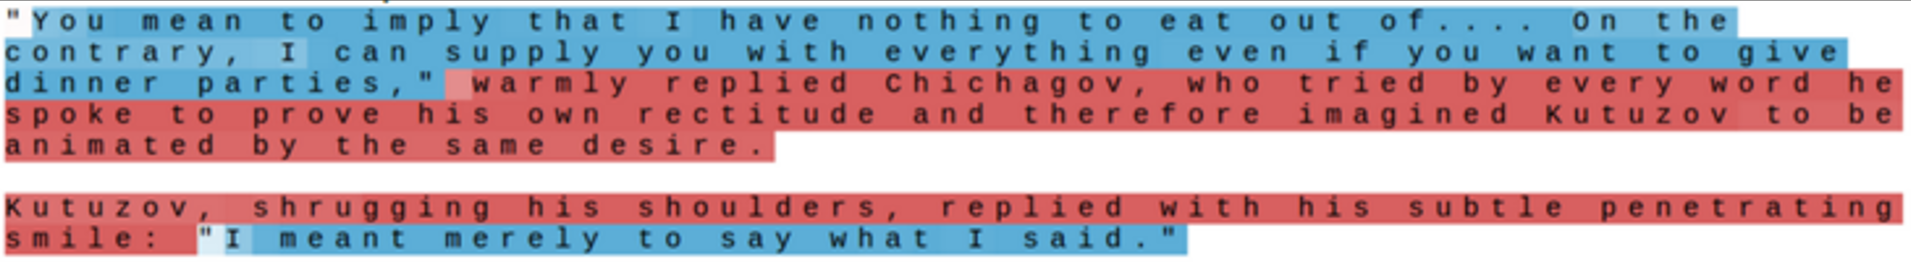
Searching for Interpretable Hidden Units
quote detection cell
Karpathy, Johnson, and Fei-Fei: Visualizing and Understanding Recurrent Networks, ICLR Workshop 2016 Figures copyright Karpathy, Johnson, and Fei-Fei; reproduced with permission
Notes:
Neural network has learned the binary switch as to whether or not you are in a quoted text or not.
Language models learn how people speak; not how people think; it can only “think” as good as the thoughts are expressed in a language so that a neural network can model it.
We only care about what the model relays to us, it needs to only approximate human thinking.

Slide 62
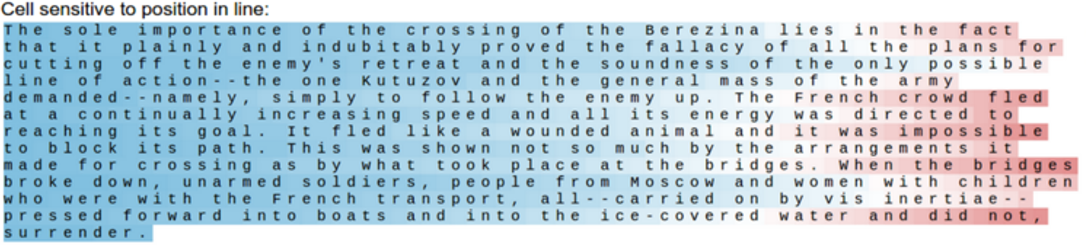
Searching for Interpretable Hidden Units
line length tracking cell
Karpathy, Johnson, and Fei-Fei: Visualizing and Understanding Recurrent Networks, ICLR Workshop 2016 Figures copyright Karpathy, Johnson, and Fei-Fei; reproduced with permission
Notes:
Tracking carriage return.
Data set fed to model had lines sequences of given lengths before carriage return
Based on that data fed to the model, the model can predict when the line will end (i.e. when it begins to fade red, showing that the model is predicting stronger and stronger that carriage return is imminent).

Slide 63
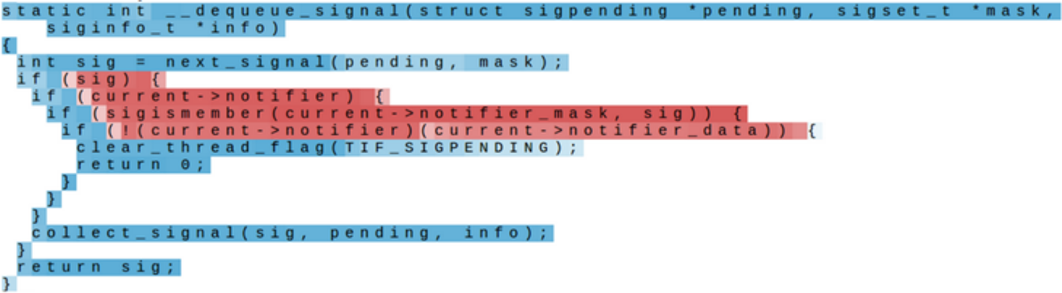
Searching for Interpretable Hidden Units
if statement cell
Karpathy, Johnson, and Fei-Fei: Visualizing and Understanding Recurrent Networks, ICLR Workshop 2016 Figures copyright Karpathy, Johnson, and Fei-Fei; reproduced with permission
Notes:
Model able to predict the format after the word “if”

Slide 64
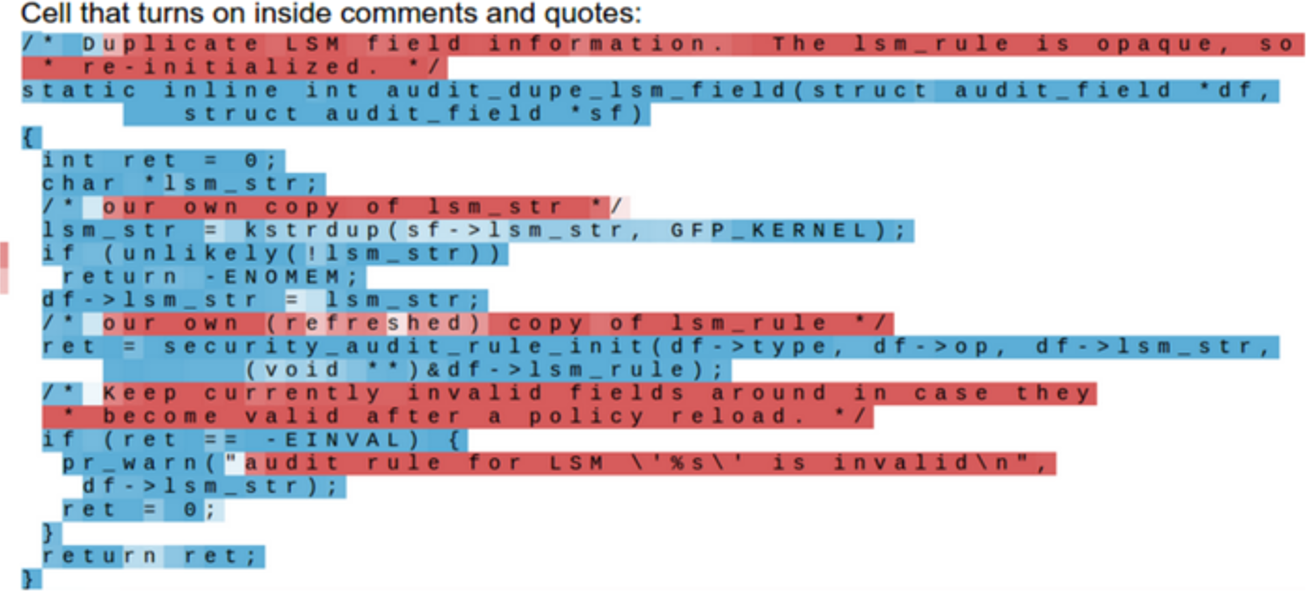
Searching for Interpretable Hidden Units
quote/comment cell
Karpathy, Johnson, and Fei-Fei: Visualizing and Understanding Recurrent Networks, ICLR Workshop 2016 Figures copyright Karpathy, Johnson, and Fei-Fei; reproduced with permission

Slide 65
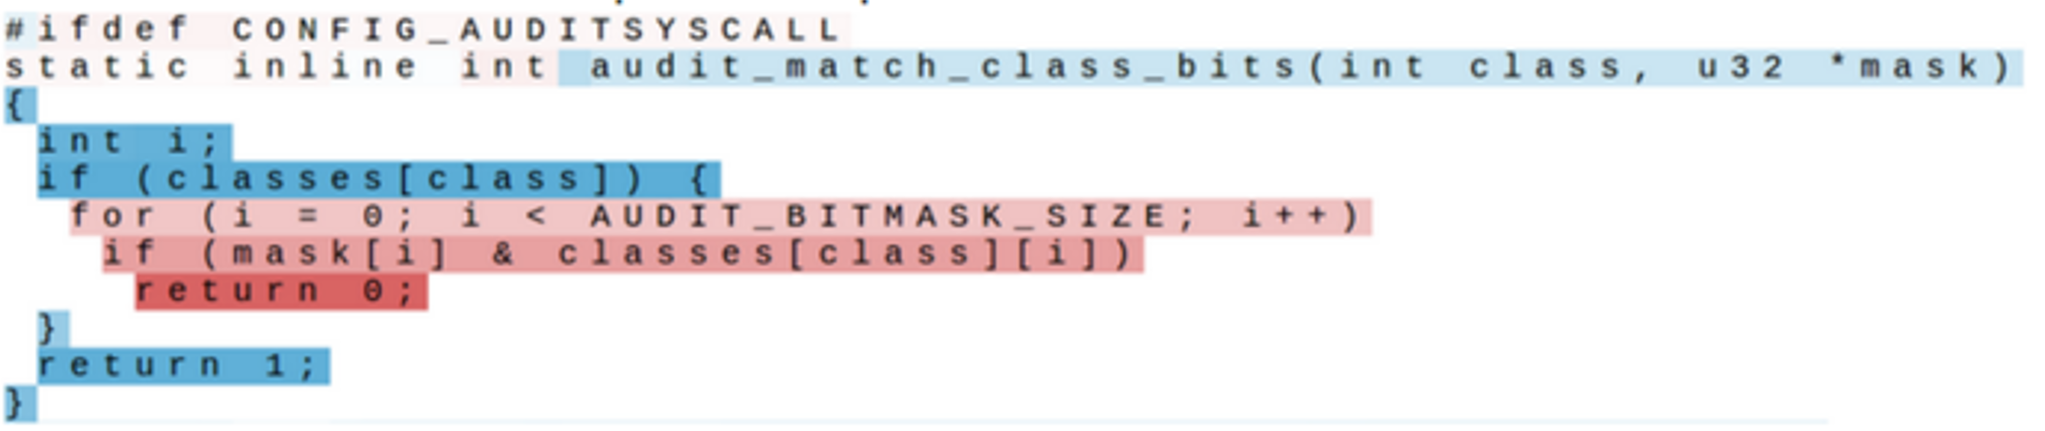
Searching for Interpretable Hidden Units
code depth cell
Karpathy, Johnson, and Fei-Fei: Visualizing and Understanding Recurrent Networks, ICLR Workshop 2016 Figures copyright Karpathy, Johnson, and Fei-Fei; reproduced with permission

Slide 66
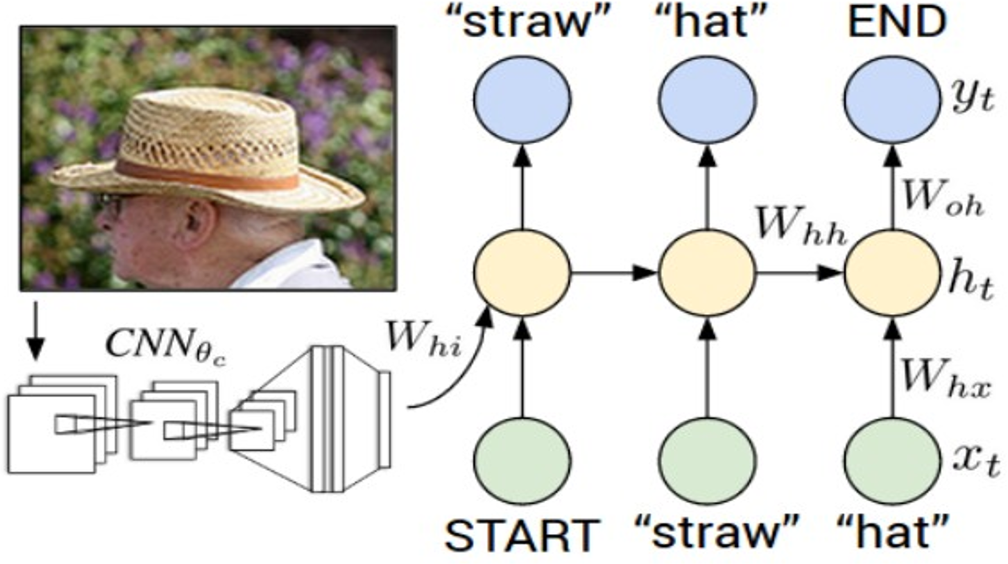
Example: Image Captioning
Mao et al, “Explain Images with Multimodal Recurrent Neural Networks”, NeurIPS 2014 Deep Learning and Representation Workshop Karpathy and Fei-Fei, “Deep Visual-Semantic Alignments for Generating Image Descriptions”, CVPR 2015
Vinyals et al, "Show and Tell: A Neural Image Caption Generator”, CVPR 2015
Donahue et al, “Long-term Recurrent Convolutional Networks for Visual Recognition and Description”, CVPR 2015
Chen and Zitnick, “Learning a Recurrent Visual Representation for Image Caption Generation”, CVPR 2015
Figure from Karpathy et a, “Deep Visual-Semantic Alignments
for Generating Image Descriptions”, CVPR 2015
Notes:
Multimodel: mix CNN and RNN (this is how GPT-4 can take text and vision input and give output).
One-to-many problem.

Slide 67
Example: Image Captioning
Recurrent Neural Network
Convolutional Neural Network
Figure from Karpathy et a, “Deep Visual-Semantic Alignments for Generating Image Descriptions”, CVPR 2015
Lecture 12 - 70
Notes:
The model was trained using images with captions associated with them.

Slide 68
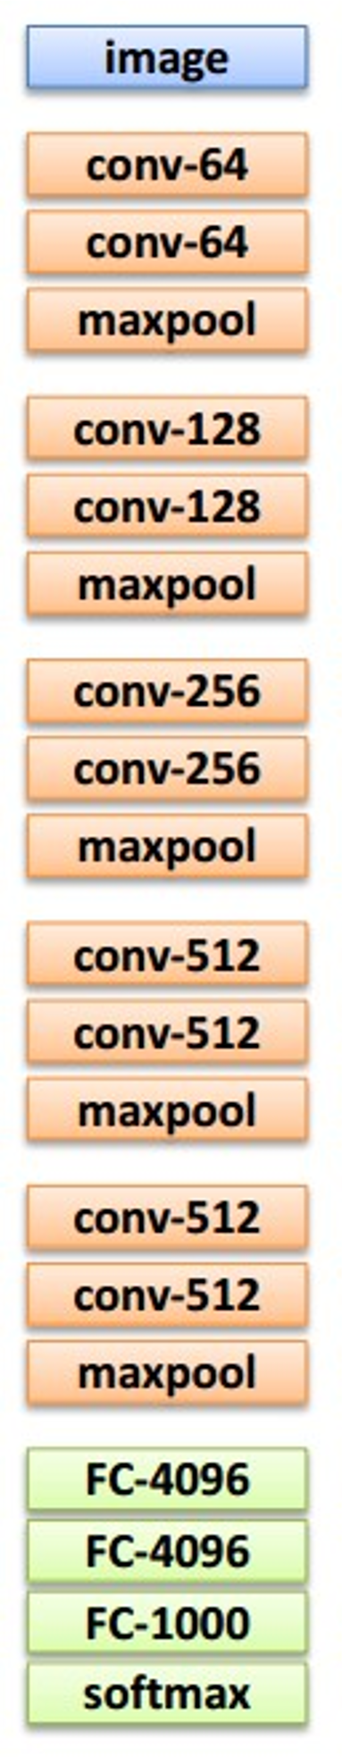

Transfer learning: Take CNN trained on ImageNet, chop off last layer
This image is CC0 public domain
X
Notes:
Last layer = fully connected classification layers; chop that off, plug it into the next model (the RNN model).

Slide 69
This image is CC0 public domain
x0
<START>

Slide 70
This image is CC0 public domain
y0
Before:
ℎ = tanh 𝑾_{xh}*x + 𝑾_{hh}*h
h0
Now:
tanh 𝑾_{xh}*x + 𝑾_{hh}*h + 𝑾_{𝒊𝒉}v
x0
^{W}ih
<START>
Notes:
v=image input extracted from convolution neural net
x=current text input
h=previous hidden layer state
The Ws are the matrices, where the weights in those matrices are trainable.
Remember, tanh is the activation function, where the linear combination of the linear transformations for x h and v are passed in.

Slide 71
This image is CC0 public domain
man
y0
Sample word and copy to input
Before:
ℎ = tanh 𝑾_{xh}*x + 𝑾_{hh}*h
h0
Now:
tanh 𝑾_{xh}*x + 𝑾_{hh}*h + 𝑾_{𝒊𝒉}v
x0
^{W}ih
man
<START>
Notes:
Now the next run will be based on “man” being the previous token; thus model now needs to predict the next word based on if “man” was the previous predicted word.

Slide 72
This image is CC0 public domain
man
in
y0
y1
Sample word and copy to input
Before:
ℎ = tanh 𝑾_{xh}*x + 𝑾_{hh}*h
h0
h1
Now:
tanh 𝑾_{xh}*x + 𝑾_{hh}*h + 𝑾_{𝒊𝒉}v
x1
x0
^{W}ih
man
in
<START>

Slide 73
This image is CC0 public domain
man
in
straw
y0
y1
y2
Sample word and copy to input
Before:
ℎ = tanh 𝑾_{xh}*x + 𝑾_{hh}*h
h0
h1
h2
Now:
tanh 𝑾_{xh}*x + 𝑾_{hh}*h + 𝑾_{𝒊𝒉}v
x1
x2
x0
^{W}ih
man
in
straw
<START>

Slide 74
This image is CC0 public domain
man
in
straw
hat
y0
y1
y2
y3
Sample word and copy to input
Before:
ℎ = tanh 𝑾_{xh}*x + 𝑾_{hh}*h
h0
h1
h2
h3
Now:
tanh 𝑾_{xh}*x + 𝑾_{hh}*h + 𝑾_{𝒊𝒉}v
x1
x2
x3
x0
^{W}ih
man
in
straw
hat
<START>
Notes:
Goal is to tune the W parameters to make a better prediction (use back propagation).
Prediction is based on current input at time t, and previous in put at time t-1; so this can be a drawback/limitation as RNN often assumes that all of the rest of the predictions of previous hidden states will be preserved through the weights.

Slide 75
This image is CC0 public domain
Stop after sampling <END> token
man
in
straw
hat
<END>
y0
y1
y2
y3
y4
Before:
ℎ = tanh 𝑾_{xh}*x + 𝑾_{hh}*h
h0
h1
h2
h3
h4
Now:
tanh 𝑾_{xh}*x + 𝑾_{hh}*h + 𝑾_{𝒊𝒉}v
x1
x2
x3
x4
x0
^{W}ih
man
in
straw
hat
<START>
Notes:
We train the model to predict when the sequence should end.
So we have tokens a-z, but we add 2 more tokens to the 26-element vector to be 28 elements → start+a-z+end
Otherwise, the model would generate words (run on sentences) without stopping.

Slide 76

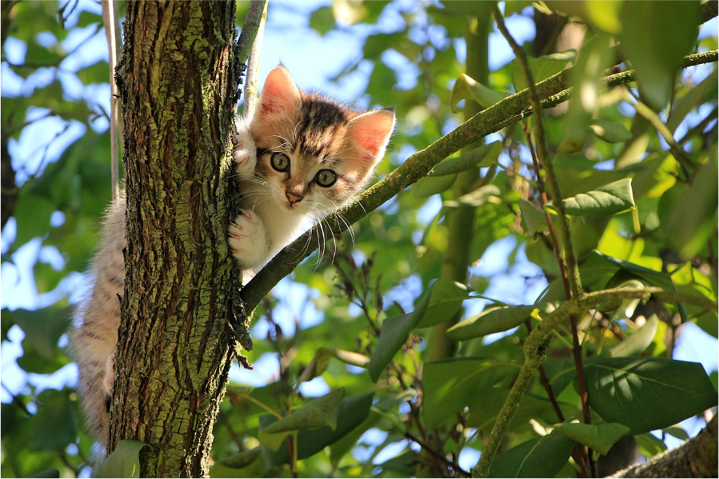
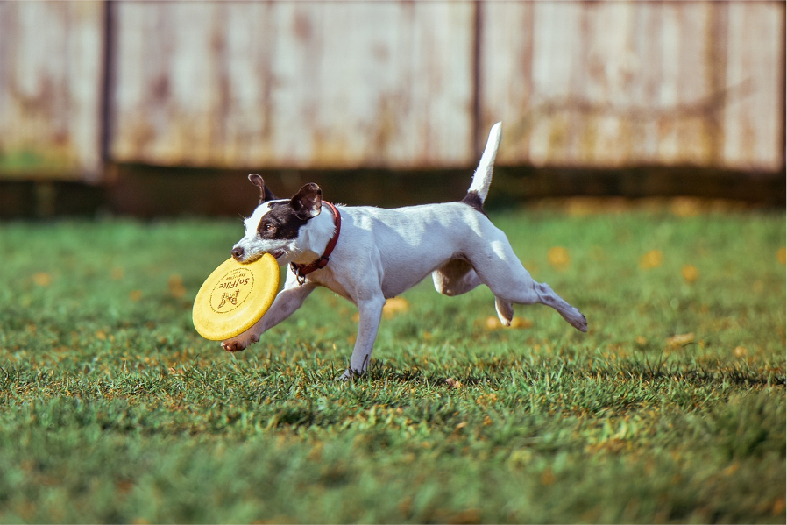
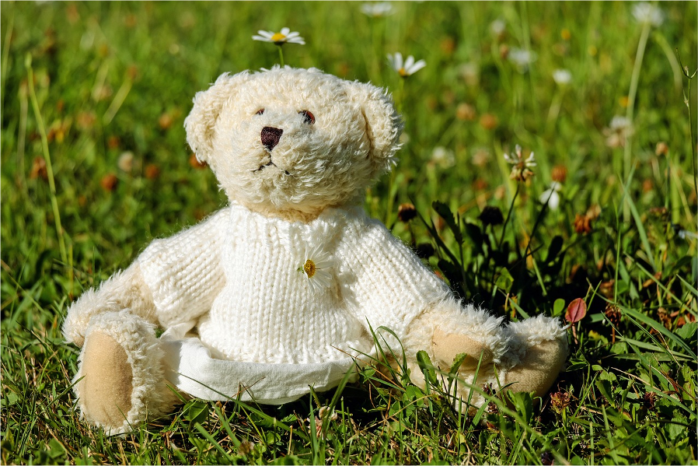

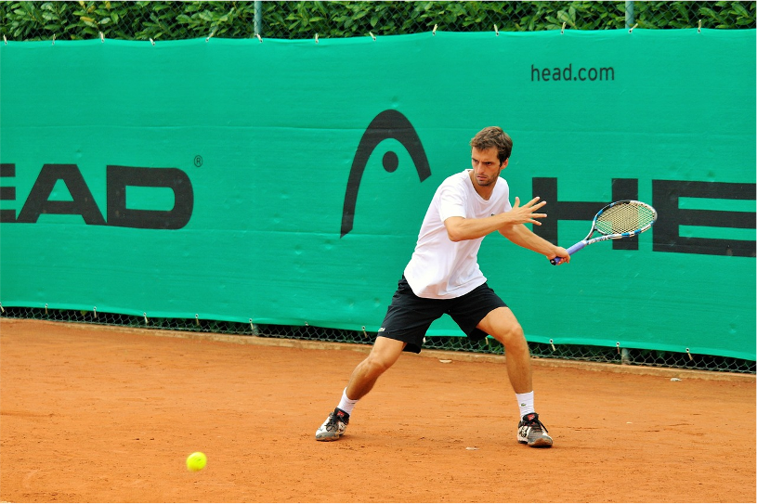
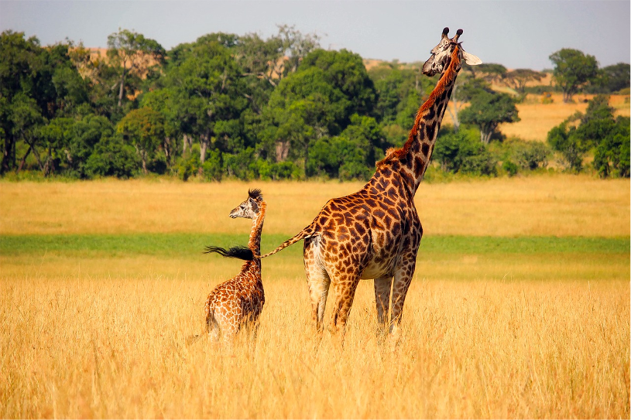
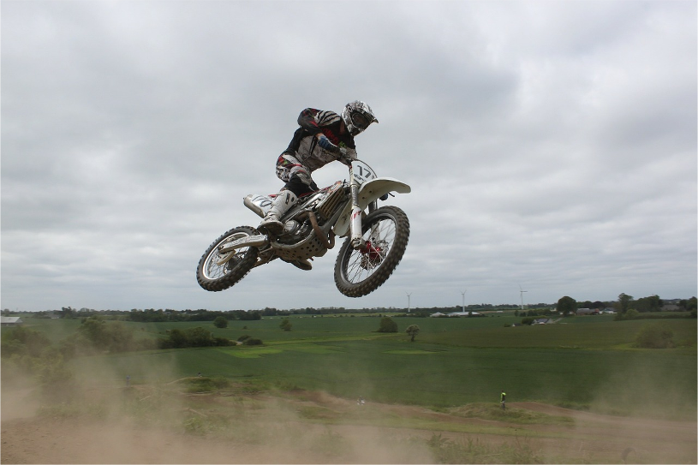
Image Captioning: Example Results
Captions generated using neuraltalk2 All images are CC0 Public domain: cat suitcase, cat tree, dog, bear, surfers, tennis, giraffe, motorcycle
A cat sitting on a suitcase on the floor
A cat is sitting on a tree branch
A dog is running in the grass with a frisbee
A white teddy bear sitting in the grass
Two people walking on the beach with surfboards
A tennis player in action on the court
Two giraffes standing in a grassy field
A man riding a dirt bike on a dirt track

Slide 77

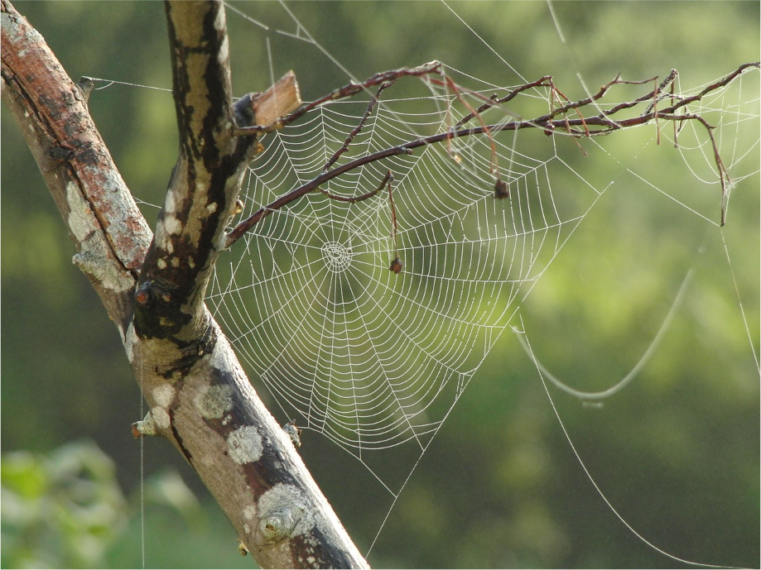



Captions generated using neuraltalk2
All images are CC0 Public domain: fur coat, handstand, spider web, baseball
Image Captioning: Failure Cases
A bird is perched on a tree branch
A woman is holding a cat in her hand
A man in a baseball uniform throwing a ball
A woman standing on a beach holding a surfboard
A person holding a computer mouse on a desk
Notes:
MAIN IDEA: PUT IMAGE THROUGH CNN, THEN ASSOCIATE THE OUTPUT OF THE CNN WITH WORDS BY FEEDING IT THROUGH A RNN

Slide 78
Vanilla RNN Gradient Flow
ℎ_{t} = tanh 𝑊_{hh}ℎ_{t-1}+W_{xh}𝑥_{t}
^{ℎ}t-1
W
tanh
= tanh
^{𝑊}hh
^{𝑊}xh
𝑥_{t}
h
stack
h
t-1
t
= tanh 𝑊 ^{ℎt-1}
𝑥_{t}
x_{t}
Bengio et al, “Learning long-term dependencies with gradient descent is difficult”, IEEE Transactions on Neural Networks, 1994 Pascanu et al, “On the difficulty of training recurrent neural networks”, ICML 2013
Notes:
x_t current input
h_t-1 is previous hidden state.

Slide 79
Vanilla RNN Gradient Flow
Backpropagation from h_{t} to h_{t-1} multiplies by W (actually W_{hh}^{T})
ℎ_{t} = tanh 𝑊_{hh}ℎ_{t-1}+W_{xh}𝑥_{t}
^{ℎ}t-1
W
tanh
= tanh
^{𝑊}hh
^{𝑊}xh
𝑥_{t}
h
stack
h
t-1
t
= tanh 𝑊 ^{ℎt-1}
𝑥_{t}
x_{t}
Bengio et al, “Learning long-term dependencies with gradient descent is difficult”, IEEE Transactions on Neural Networks, 1994 Pascanu et al, “On the difficulty of training recurrent neural networks”, ICML 2013
Notes:
Tanh gradients can cause slow training because close to 1 or -1, the slope is very very small, so weights will not change as much: solution may be to use RELU activation function instead.

Slide 80
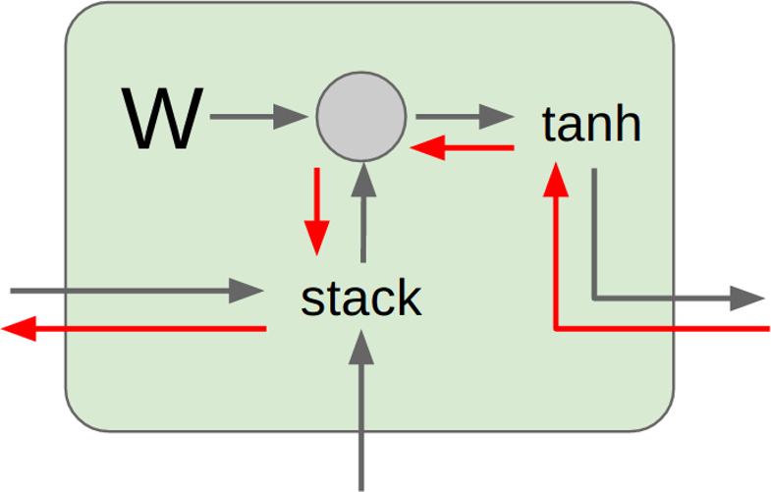
Vanilla RNN Gradient Flow
h₀
h₁
h₂
h₃
h₄
x₁
x₂
x₃
x₄
Computing gradient of h₀ involves many factors of W
(and repeated tanh)

Slide 81
Vanilla RNN Gradient Flow
h₀
h₁
h₂
h₃
h₄
x₁
x₂ x₃
Largest singular value > 1:
Exploding gradients
x₄
Computing gradient of h₀ involves many factors of W
(and repeated tanh)
Largest singular value < 1:
Vanishing gradients

Slide 82
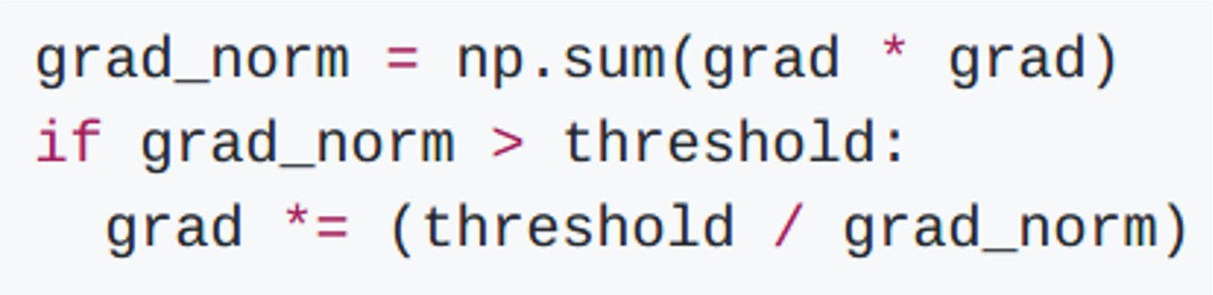
Vanilla RNN Gradient Flow
h₀
h₁
h₂
h₃
h₄
x₁
x₂ x₃
x₄
Largest singular value > 1:
Exploding gradients
Gradient clipping: Scale gradient if its norm is too big
Computing gradient of
h involves many
0
factors of W
(and repeated tanh)
Largest singular value < 1:
Vanishing gradients
Notes:
Exploding gradient from W multiplied by itself growing too large (because singular value > 1)
Vanishing gradient from W multiplied by itself vanish → goes to 0 = no gradient (because singular value < 1)

Slide 83
Vanilla RNN Gradient Flow
h₀
h₁
h₂
h₃
h₄
x₁
x₂ x₃
Largest singular value > 1:
Exploding gradients
x₄
Computing gradient of h₀ involves many factors of W
(and repeated tanh)
Largest singular value < 1:
Vanishing gradients
Change RNN architecture!

Slide 84
Long Short Term Memory (LSTM)
Vanilla RNN
ℎ_{t}= tanh 𝑊 ^{ℎt-1}
𝑥_{t}
Hochreiter and Schmidhuber, “Long Short Term Memory”, Neural Computation 1997

Slide 85
Long Short Term Memory (LSTM)
Vanilla RNN
LSTM
𝑖
𝑓
𝑜
𝜎
𝜎
𝜎
ℎ_{t}= tanh 𝑊 ^{ℎt-1}
𝑥_{t}
_{𝑊} ^{ℎ}t-1
=
𝑥_{t}
𝑔 tanh
𝑐_{t} = 𝑓⊙ 𝑐_{t-1} + 𝑖 ⊙ 𝑔 ℎ_{t} = 𝑜 ⊙ tanh 𝑐_{t}
Hochreiter and Schmidhuber, “Long Short Term Memory”, Neural Computation 1997

Slide 86
Long Short Term Memory (LSTM)
Vanilla RNN
LSTM
𝑖
𝑓
𝑜
𝜎
𝜎
𝜎
ℎ_{t}= tanh 𝑊 ^{ℎt-1}
𝑥_{t}
_{𝑊} ^{ℎ}t-1
=
𝑥_{t}
𝑔 tanh
𝑐_{t} = 𝑓⊙ 𝑐_{t-1} + 𝑖 ⊙ 𝑔 ℎ_{t} = 𝑜⊙ tanh 𝑐_{t}
Two vectors at each timestep:
Cell state
Hidden state
Hochreiter and Schmidhuber, “Long Short Term Memory”, Neural Computation 1997

Slide 87
Long Short Term Memory (LSTM)
Vanilla RNN
LSTM
𝑖
𝑓
𝑜
𝜎
𝜎
𝜎
ℎ_{t}= tanh 𝑊 ^{ℎt-1}
𝑥_{t}
_{𝑊} ^{ℎ}t-1
=
𝑥_{t}
Compute four “gates” per timestep:
Input gate: i
Forget gate: f Output gate: o
“Gate?” gate: g
𝑔 tanh
𝑐_{t} = 𝑓⊙ 𝑐_{t-1} + 𝑖 ⊙ 𝑔 ℎ_{t} = 𝑜 ⊙ tanh 𝑐_{t}
Hochreiter and Schmidhuber, “Long Short Term Memory”, Neural Computation 1997

Slide 88
Long Short Term Memory (LSTM)
i: Input gate, whether to write to cell
f: Forget gate, Whether to erase cell
o: Output gate, How much to reveal cell
Input vector (x)
g: Gate gate (?), How much to write to cell
W
x
sigmoid
i
𝑖
𝑓
𝑜
𝜎
𝜎
𝜎
h
sigmoid
f
_{𝑊} ^{ℎ}t-1
=
𝑥_{t}
sigmoid
o
Previous hidden state (h)
𝑔 tanh
𝑐_{t} = 𝑓⊙ 𝑐_{t-1} + 𝑖 ⊙ 𝑔 ℎ_{t} = 𝑜 ⊙ tanh 𝑐_{t}
tanh
g
4h x 2h
4h
4*h
Notes:
Ct is intermediate state (called cell sate) is used in order to make the model more flexible by allowing input to be forgotten/not used to some degree through using the gates.

Slide 89
Long Short Term Memory (LSTM)
^{c}t-1
☉
+
c_{t}
f
𝑖
𝑓
𝑜
𝜎
𝜎
𝜎
i g
_{𝑊} ^{ℎ}t-1
W
=
☉
tanh
𝑥_{t}
𝑔 tanh
𝑐_{t} = 𝑓⊙ 𝑐_{t-1} + 𝑖 ⊙ 𝑔 ℎ_{t} = 𝑜 ⊙ tanh 𝑐_{t}
^{h}t-1
stack
o
h_{t}
☉
x_{t}
Notes:
C_t = cell state
Stack = concatenate

Slide 90
Long Short Term Memory (LSTM): Gradient Flow
Backpropagation from c_{t} to c_{t-1} only elementwise
c
☉ +
c_{t}
t-1
multiplication by f, no matrix multiply by W
f
𝑖
𝑓
𝑜
𝜎
𝜎
𝜎
i g
W
_{𝑊} ^{ℎ}t-1
☉
tanh
=
𝑥_{t}
stack
𝑔 tanh
𝑐_{t} = 𝑓⊙ 𝑐_{t-1} + 𝑖 ⊙ 𝑔 ℎ_{t} = 𝑜 ⊙ tanh 𝑐_{t}
^{h}t-1
o
☉
h_{t}
x_{t}
Notes:
Top level pathway is a friendly pathway to do the backpropagation. And it is not linear, so it will not destroy information.
Think of this case as creating a highway for RNN.

Slide 91
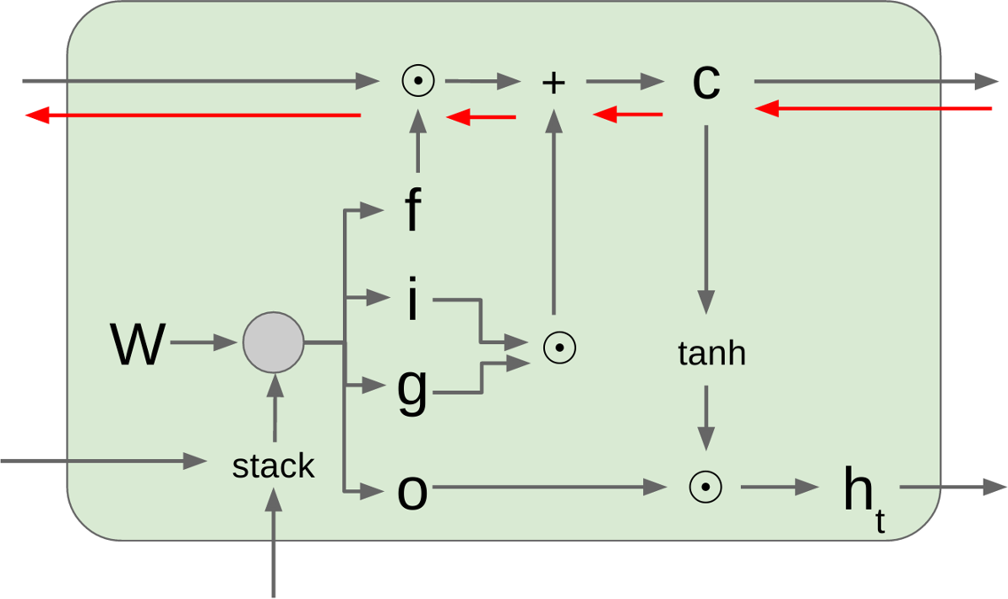
Long Short Term Memory (LSTM): Gradient Flow
Uninterrupted gradient flow!
c₁ c₂
c₀
c₃

Slide 92
Long Short Term Memory (LSTM): Gradient Flow
Uninterrupted gradient flow!
c₁ c₂
c₀
c₃
Input | 7x7 conv, 64 / 2 | Pool
Pool | FC 1000 | Softmax
Similar to ResNet!
...
3x3 conv, 128
3x3 conv, 128
3x3 conv, 128
3x3 conv, 128
3x3 conv, 128
3x3 conv, 128 / 2
3x3 conv, 64
3x3 conv, 64
3x3 conv, 64
3x3 conv, 64
3x3 conv, 64
3x3 conv, 64
3x3 conv, 64
3x3 conv, 64
3x3 conv, 64
3x3 conv, 64
3x3 conv, 64
3x3 conv, 64

Slide 93
Long Short Term Memory (LSTM): Gradient Flow
Uninterrupted gradient flow!
c₁ c₂
c₀
c₃
In between: Highway Networks
𝑔 = T 𝑥, 𝑊_{T}
𝑦 = 𝑔⊙ 𝐻 𝑥, WH + 1 − 𝑔 ⊙ 𝑥
Srivastava et al, “Highway Networks”, ICML DL Workshop 2015
Input | 7x7 conv, 64 / 2 | Pool
Pool | FC 1000 | Softmax
Similar to ResNet!
...
3x3 conv, 128
3x3 conv, 128
3x3 conv, 128
3x3 conv, 128
3x3 conv, 128
3x3 conv, 128 / 2
3x3 conv, 64
3x3 conv, 64
3x3 conv, 64
3x3 conv, 64
3x3 conv, 64
3x3 conv, 64
3x3 conv, 64
3x3 conv, 64
3x3 conv, 64
3x3 conv, 64
3x3 conv, 64
3x3 conv, 64

Slide 94
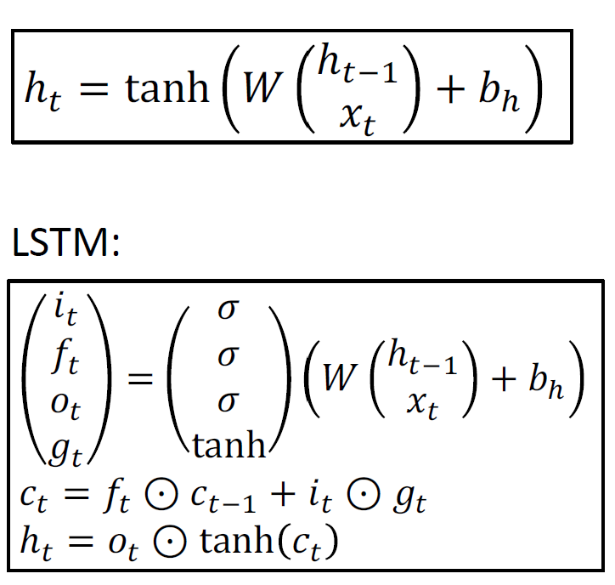
Single-Layer RNNs
y₀ |  | y₁ |  | y₂ |  | y₃ |  | y₄ |  | y₅ |  | y₆
h₀ |  | h₁ |  | h₂ |  | h₃ |  | h₄ |  | h₅ |  | h₆
x₀
x₁
x₂
x₃
x₄
x₅
x₆
time

Slide 95

Two-layer RNN: Pass hidden states from one RNN as inputs to another RNN
Mutilayer RNNs
depth
y₀
y₁
y₂
y₃
y₄
y₅
y₆
_{h}2 0 |  | _{h}2 1 |  | _{h}2 2 |  | _{h}2 3 |  | _{h}2 4 |  | _{h}2 5 |  | _{h}2 6
_{h}1 0 |  | _{h}1 1 |  | _{h}1 2 |  | _{h}1 3 |  | _{h}1 4 |  | _{h}1 5 |  | _{h}1 6
x₀
x₁
x₂
x₃
x₄
x₅
x₆
time
Notes:
Added hidden layers are treated as more input layers to the top hidden layer.

Slide 96

Mutilayer RNNs
Three-layer RNN
time

Slide 97


Other RNN Variants
10,000 architectures with evolutionary search: Jozefowicz et al, “An empirical exploration of recurrent network architectures”, ICML 2015
Gated Recurrent Unit (GRU)
Cho et al “Learning phrase representations using RNN encoder-decoder for statistical machine translation”, 2014
Notes:
GRU is just as good as LSTM; both are included in Keras library.
Some people have used brute force approach to search for best architecture.
i.e. they used a neural network to generate the most optimal network for given tasks

Slide 98


RNN Architectures: Neural Architecture Search
LSTM Learned Architecture
Zoph and Le, “Neural Architecture Search with Reinforcement Learning”, ICLR 2017
Notes:
Train a neural network to predict a LSTM neural network (that will be the optimal structure/architecture).
So instead of manually finding the architecture, use a network to find the optimal structure.
But this is extremely expensive and take A LOT OF TIME because it involves building a model, training it, testing it, and repeating that to find the model with the best accuracy.
Often, an experience machine learning engineer can more quickly find a strong enough architecture versus using a very expensive time-consuming neural network searching through thousands of architectures, albeit using weights to help converge faster (possibly) on the best architecture.

Slide 99
Summary
RNNs allow a lot of flexibility in architecture design
Vanilla RNNs are simple but don’t work very well
Common to use LSTM or GRU: additive interactions improve gradient flow
Backward flow of gradients in RNN can explode or vanish.
Exploding is controlled with gradient clipping.
Vanishing is controlled with additive interactions (LSTM)
Better/simpler architectures are a hot topic of current research
Better understanding (both theoretical and empirical) is needed.

